Slide 1
3D Modelling PORT1
St20231722
Dylan Dennis

Slide 2
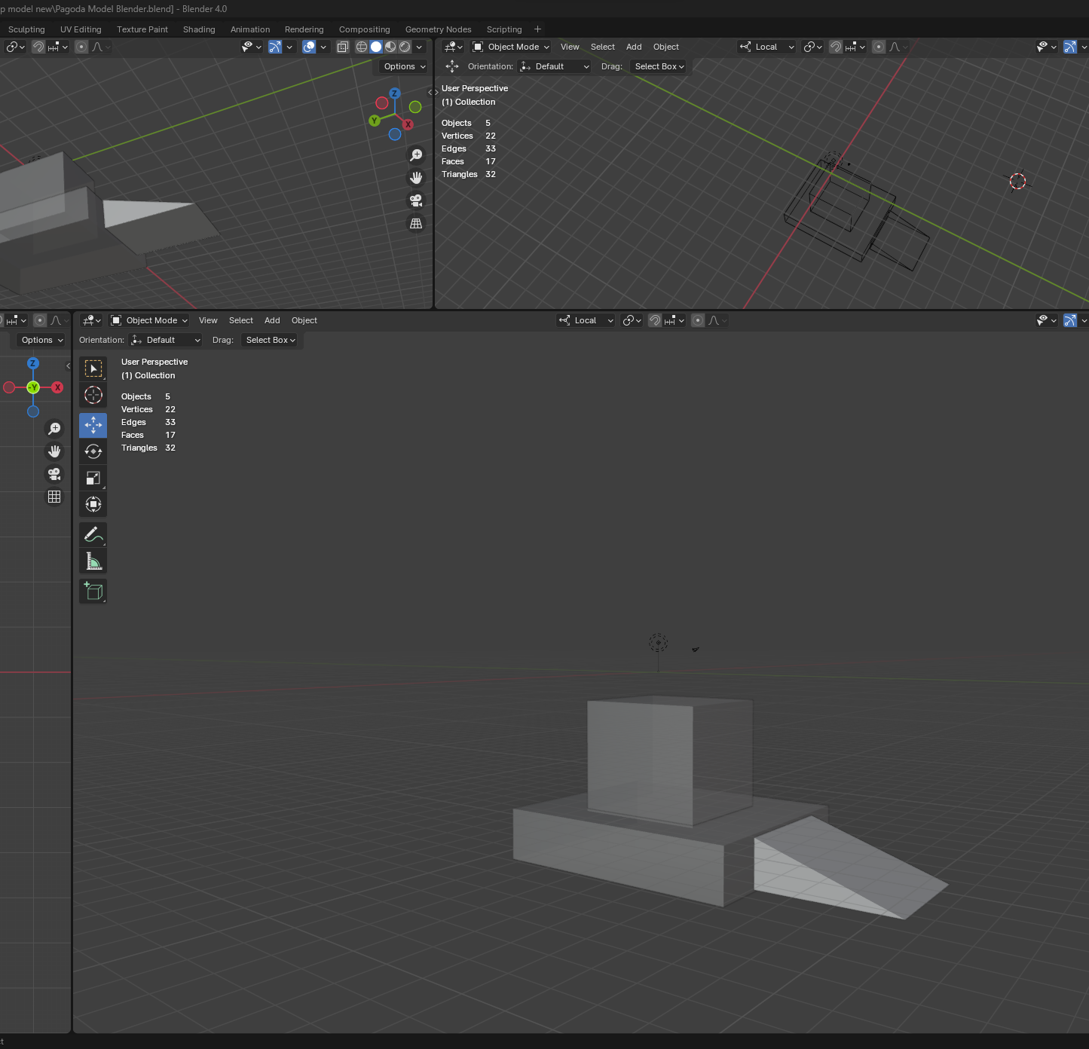
3D Modelling a Pagoda Part 1
Started by adding a number of cube meshes to represent the three main parts of the first layer of the pagoda model. Using the scale tool I altered the shape of one to flatten it and enlarge it to represent the base. While using the move tool and enabling select edges allowed me to taper the edge of one cube to create a triangular shape. Using the merge vertices option I sealed the end of the cube to avoid unnecessary vertices and faces.

Slide 3
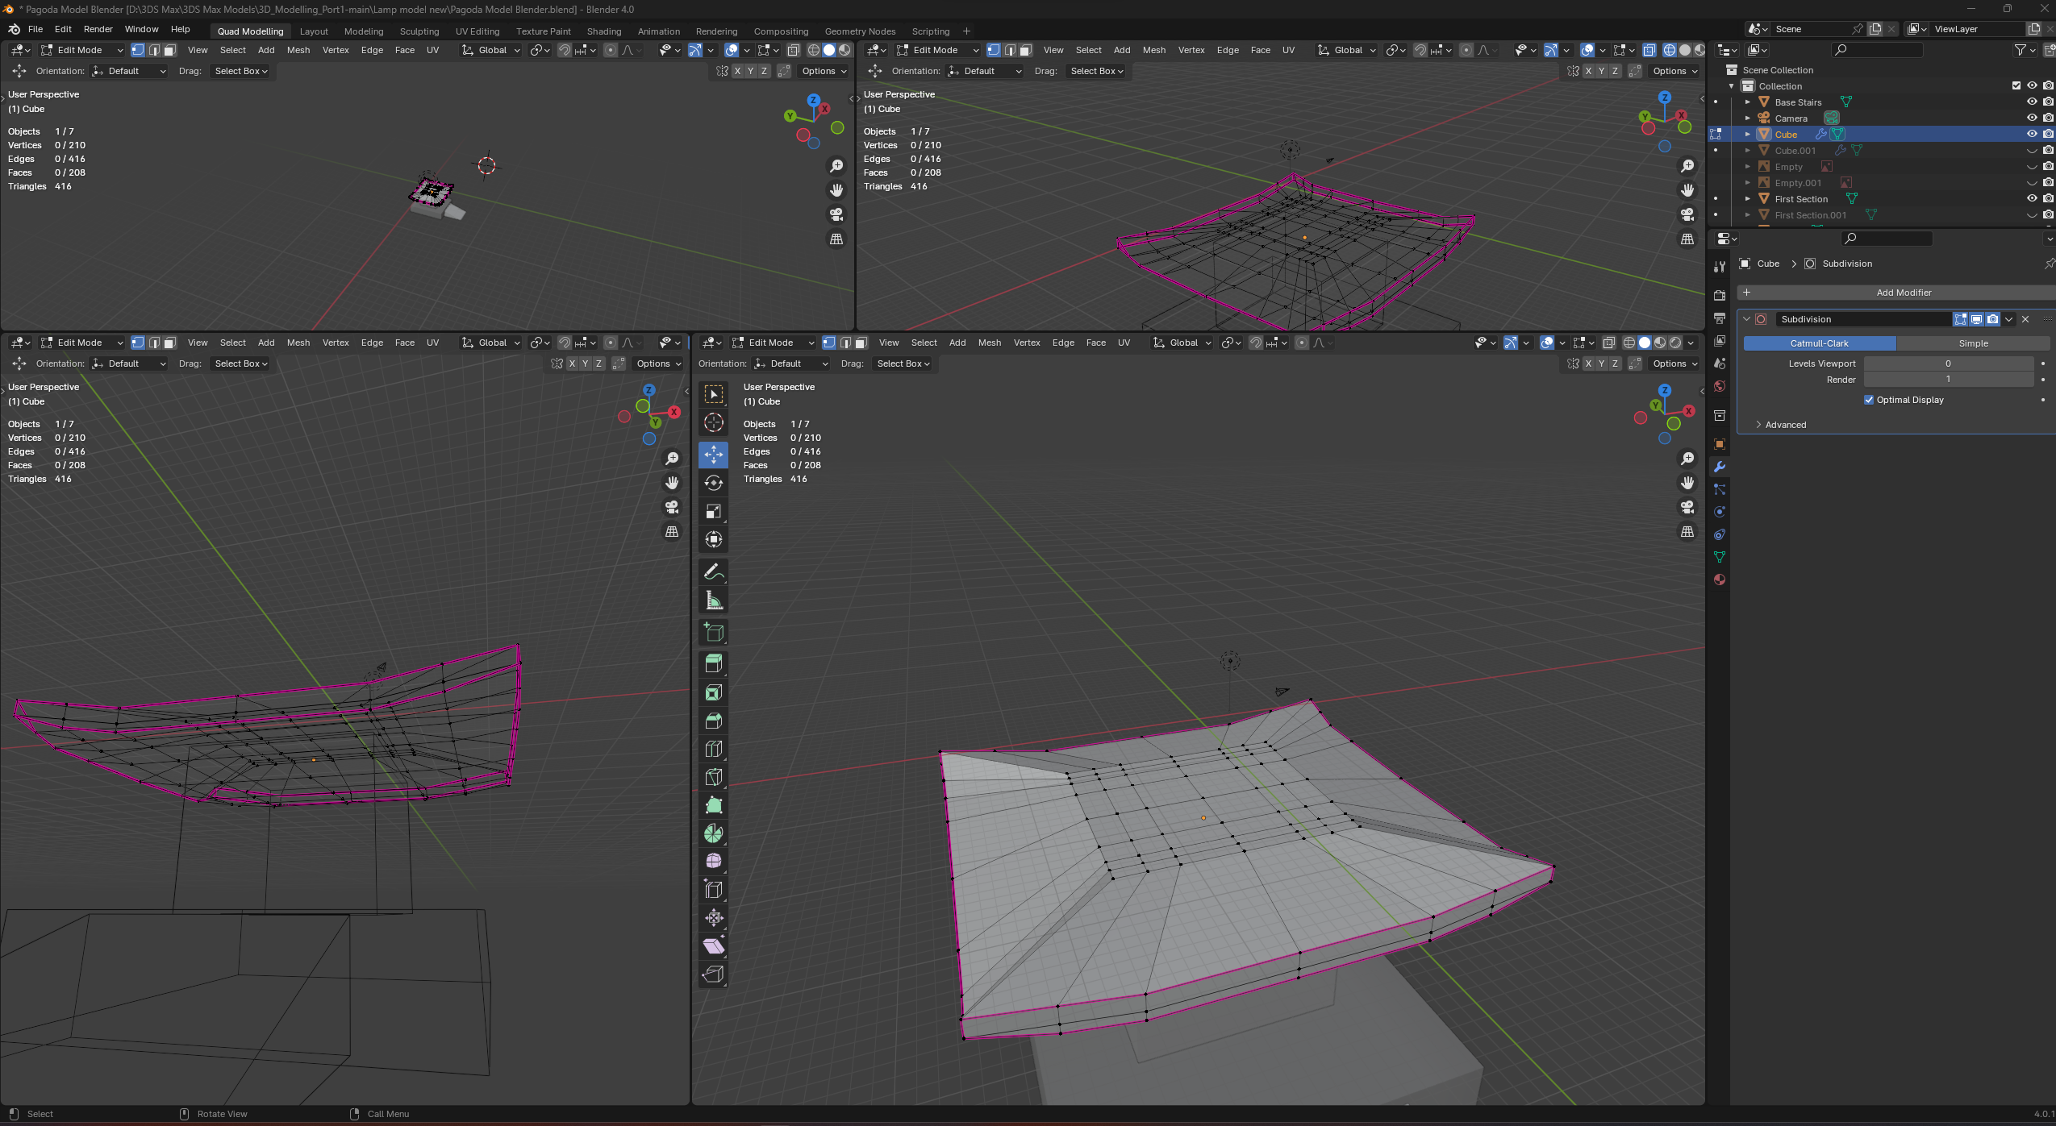
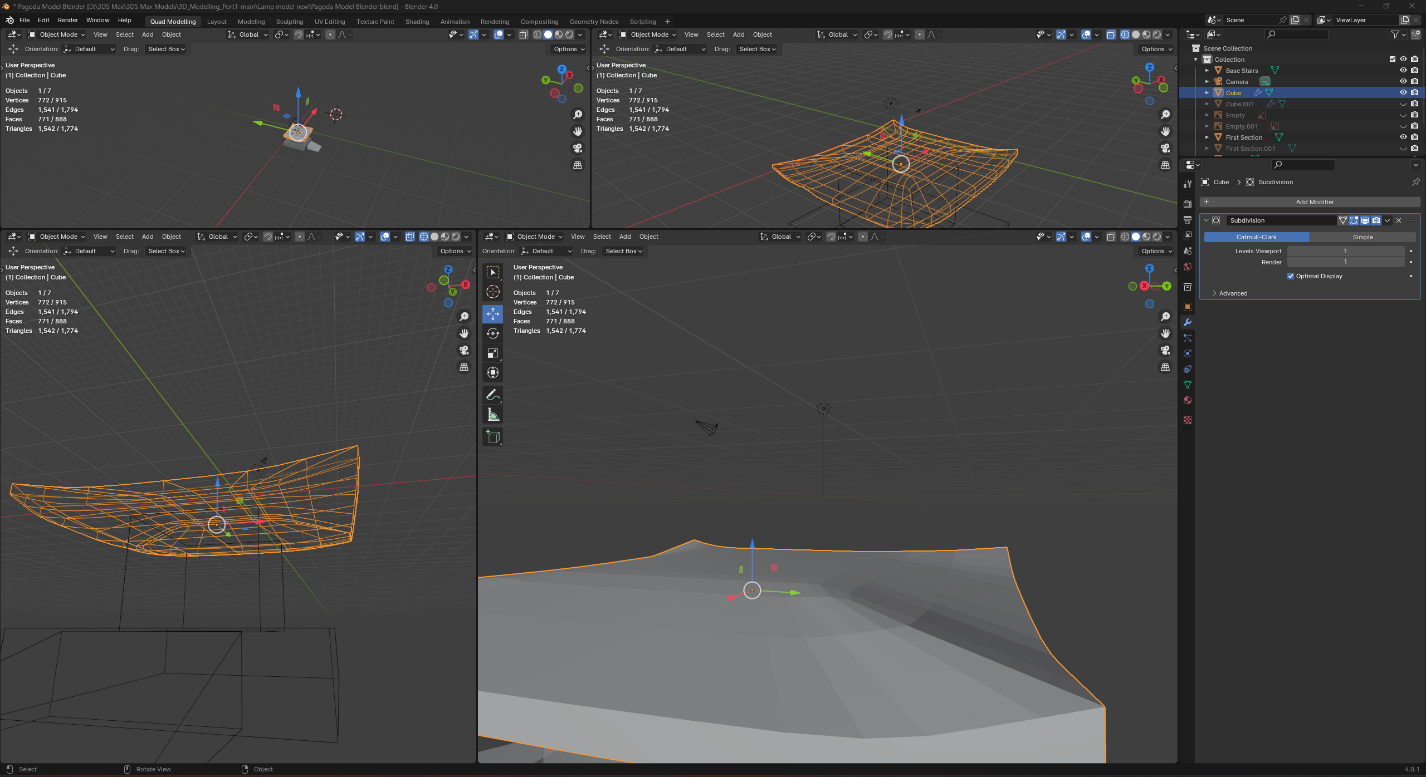
3D Modelling a Pagoda Part 2
Using the inset tool on a rectangle I added some additional interior geometry which allowed me to then create a rough curved shape along all four sides of the rectangle simultaneously. After doing so I selected all the edges along the outside of the roof (Seen In Purple in the leftmost screenshot) to add an “edge crease” which would ensure that when applying my subdivision surface modifier my edges would remain sharp and would not be rounded out ensuring I kept a sharp edge while smoothing the rough curvature I had previously laid out using inset and loop cuts to add extra geometry to edit. After applying My subdivision modifier, I opted to leave the smoothing level at one as applying too many passes of the subdivision modifier would have significantly increased the poly count of my roof which I could not afford. As I was modelling a pagoda naturally, I knew there were going to be multiple subdivided roofs so keeping the poly count down for these was paramount

Slide 4
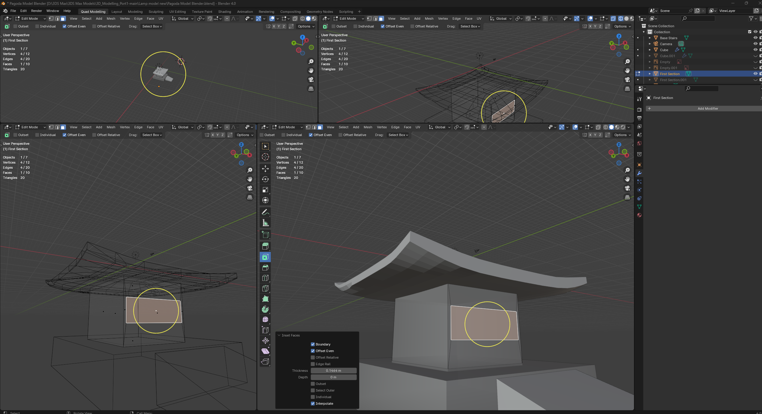
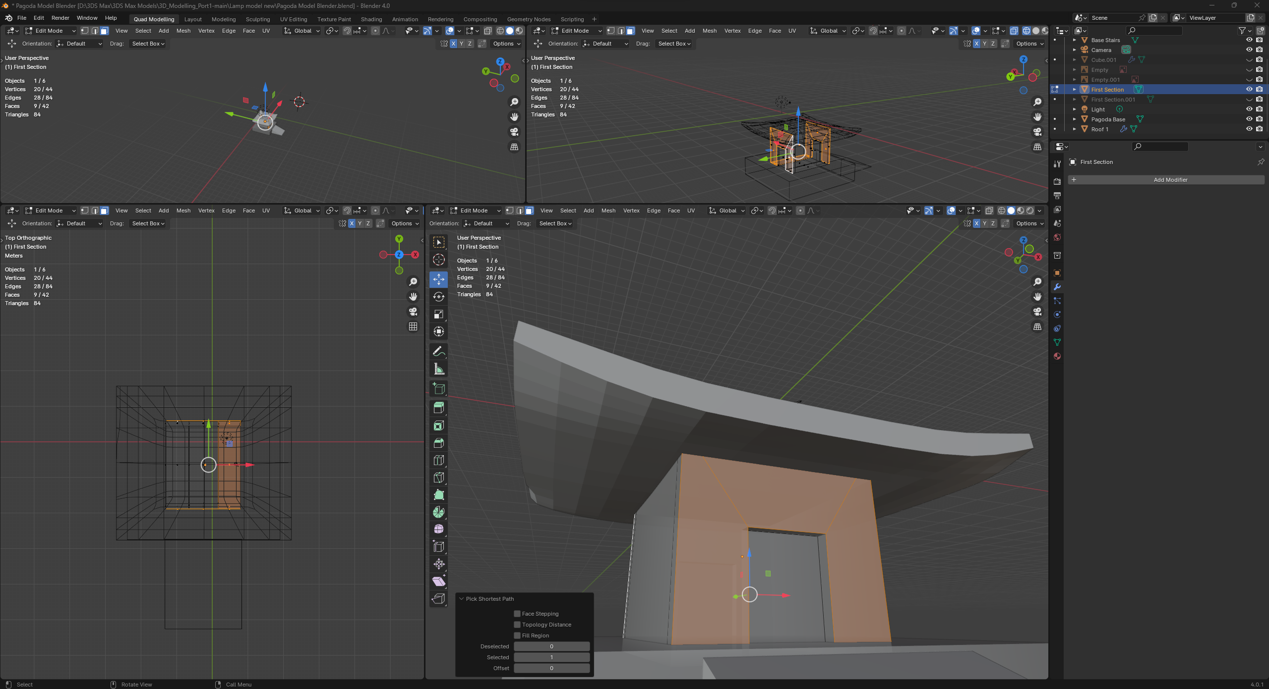
3D Modelling a Pagoda Part 3
The next step I took was to apply some depth and geometry to the first section of my pagoda. To do this I opted to first use the inset tool to create additional geometry on both the front and back of my pagoda. Using the extrude tool I was then able to create a dip in the model to represent the doorframe.

Slide 5
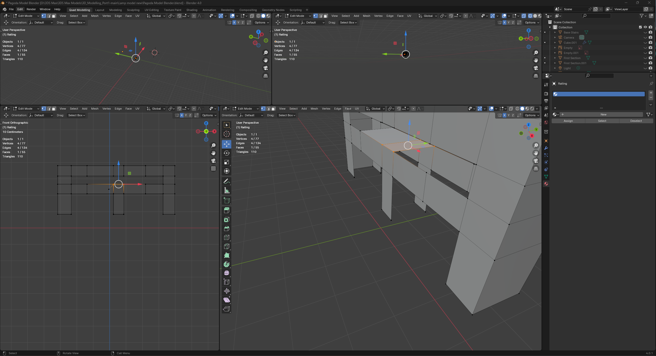
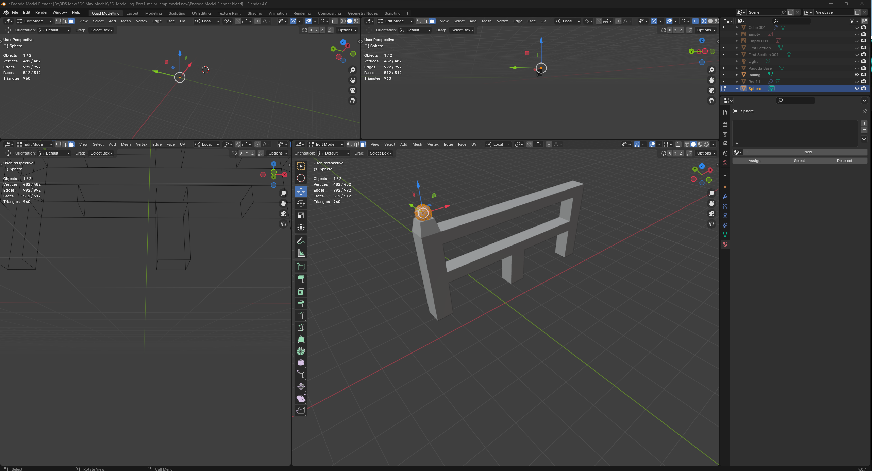
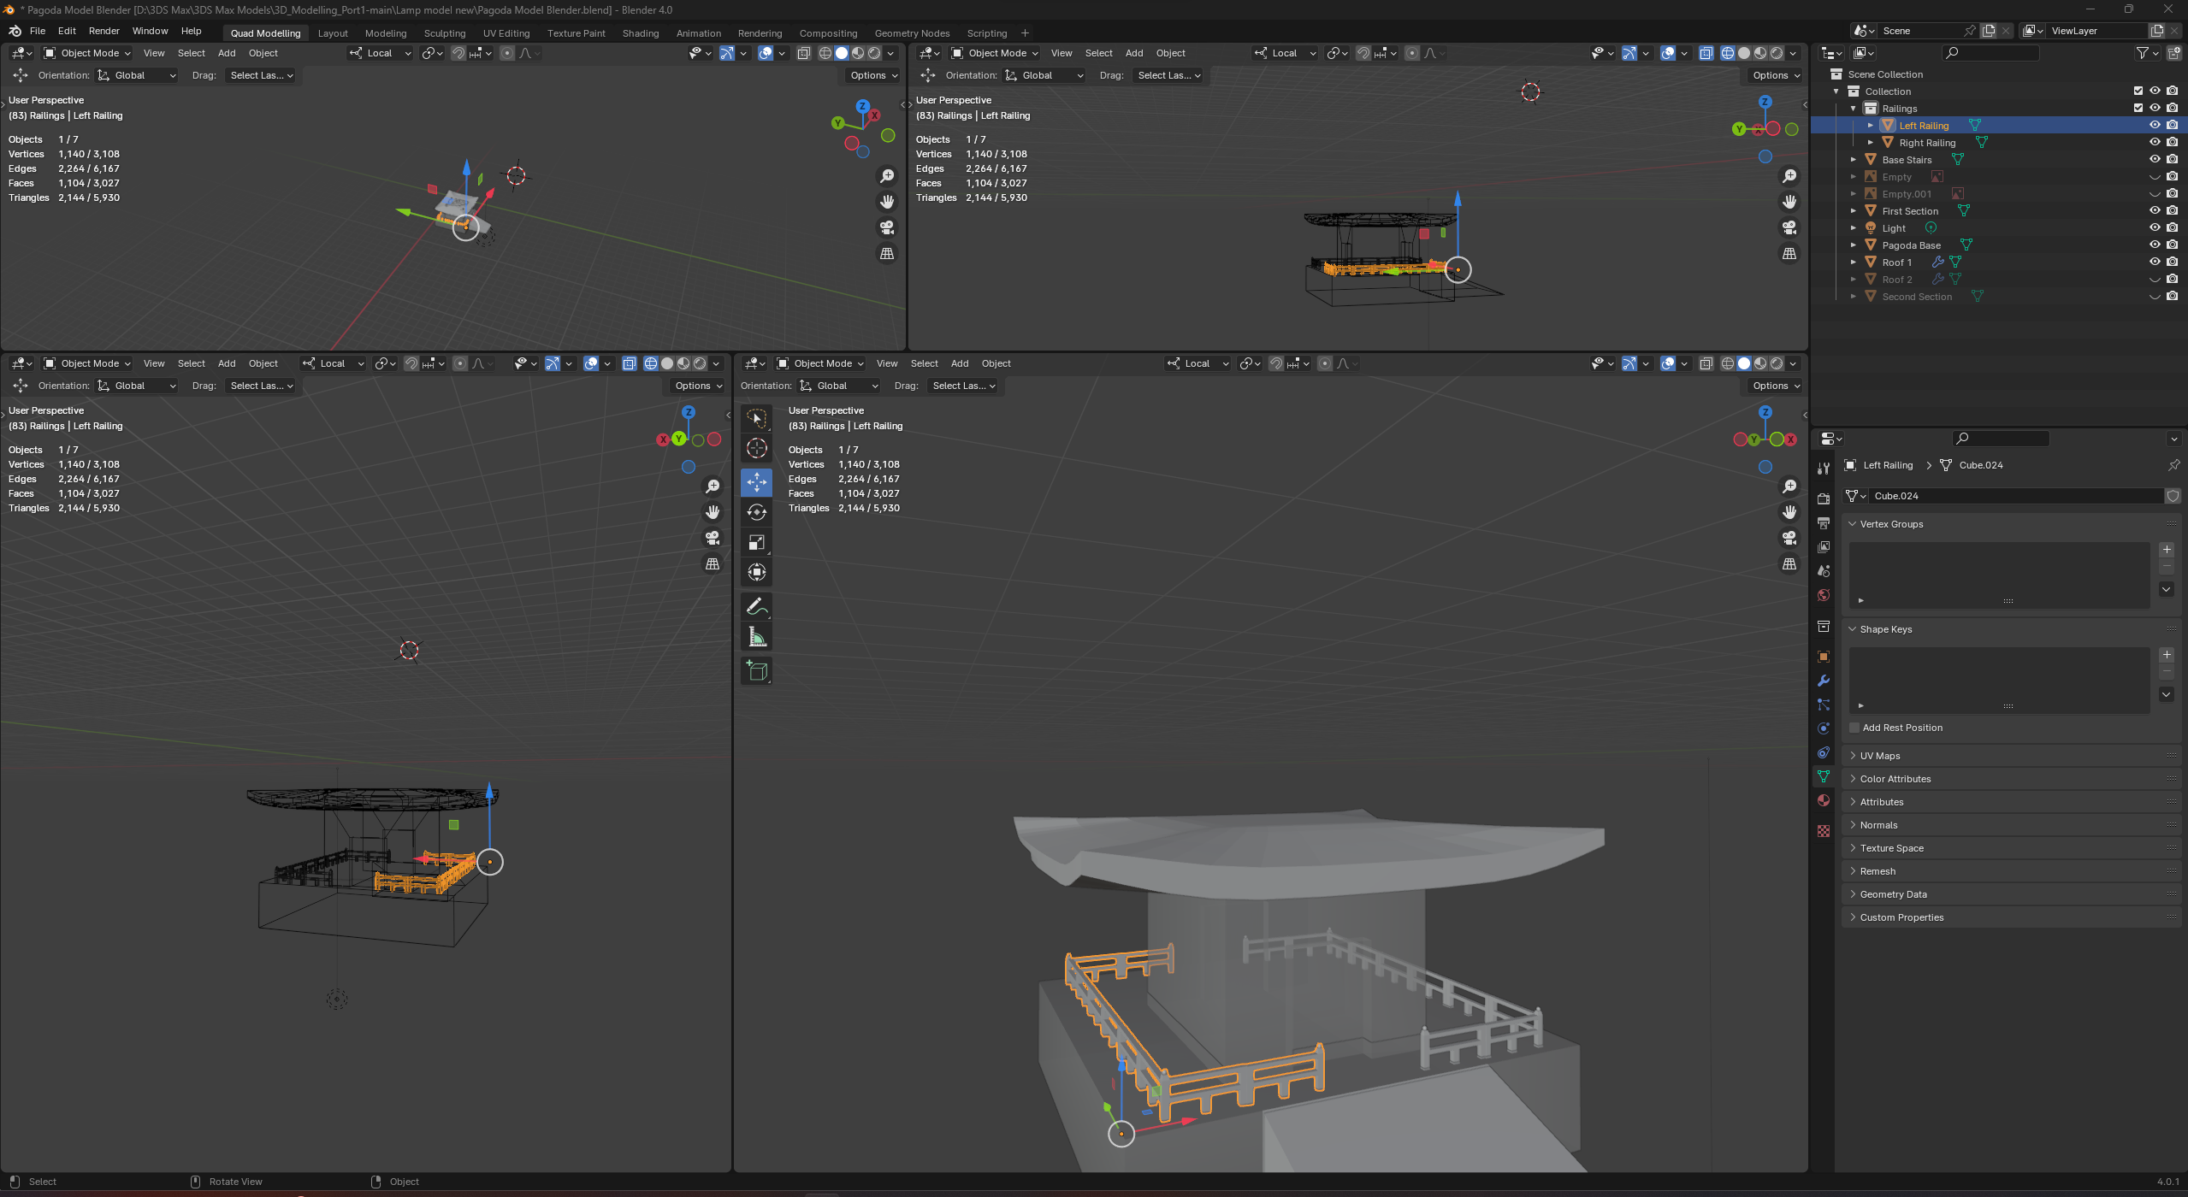
3D Modelling a Pagoda Part 4
In this stage I began modelling the fences that would adorn the various layers of my pagoda. Starting out with a base cube I utilized the loop cut (edge loop) tool to cut geometry in the shape of the fence I wanted into the cube. After this I cut out those faces that weren’t needed to create my basic shape seen in the first screenshot. After this there were many gaps between parts of the fence that needed to be linked together with geometry. To do this I would utilize the fill tool to select four different vertices and fill the space between them with faces. After filling in any gaps I decided to duplicate my fence model and then create a new variation pf it by beveling one end out and adding a sphere on top as a decoration (see screenshot 2) I first un-subdivided this ball to lower its poly count as it was only a small detail in the overall model After that I removed about half the faces from the ball as many of them would never be seen in game by the player thus making them pointless to render. Finally, I duplicated several of my fences to join into one longer fence that would go around the base.

Slide 6
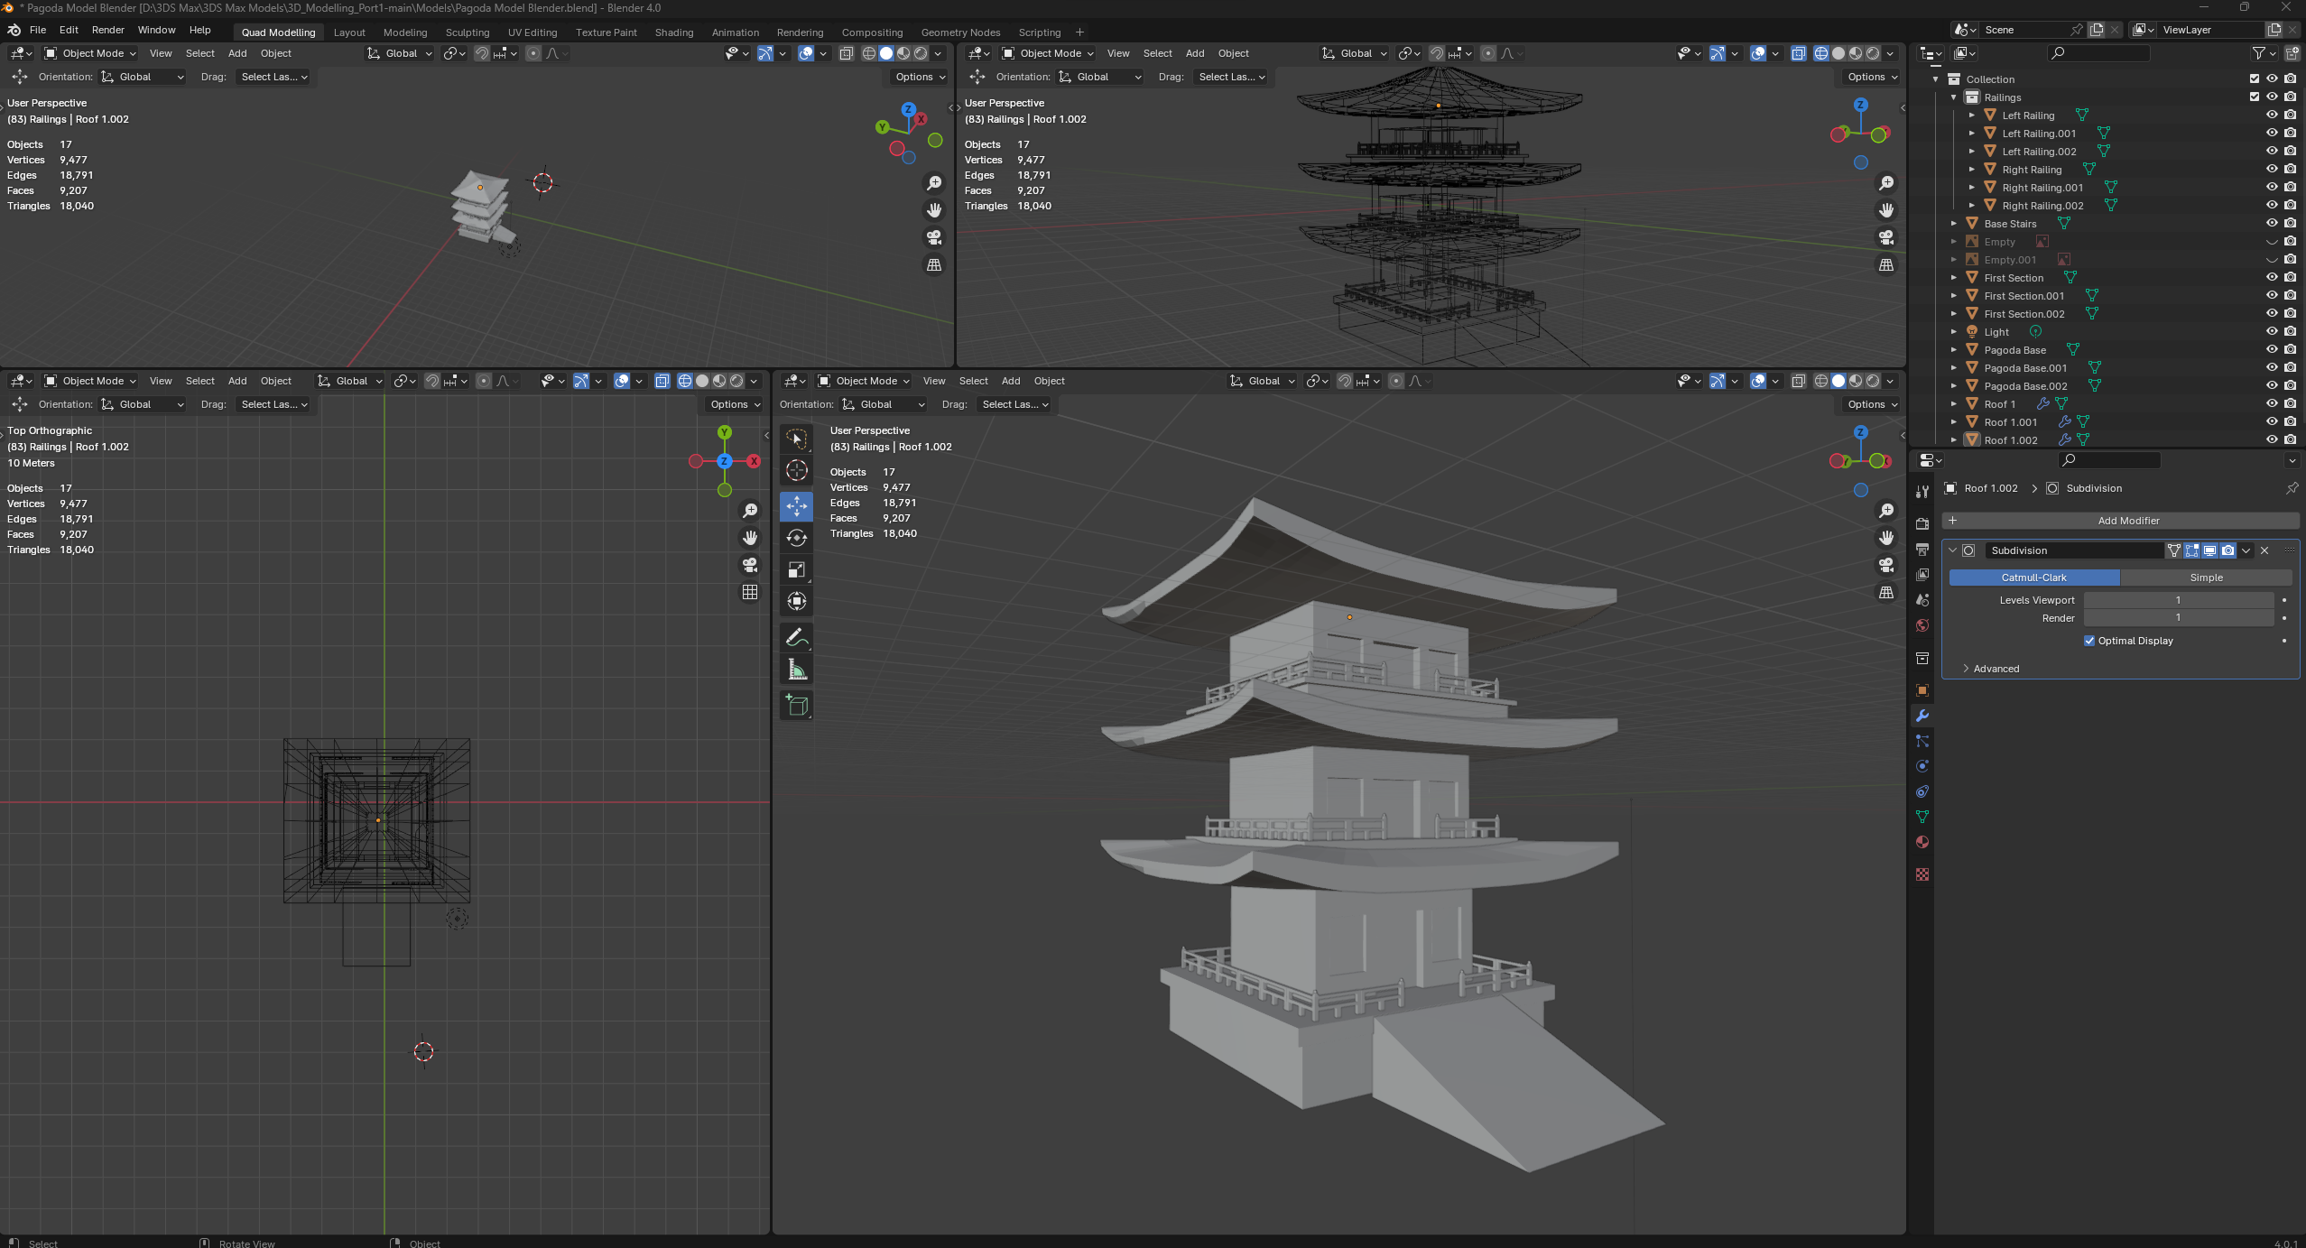
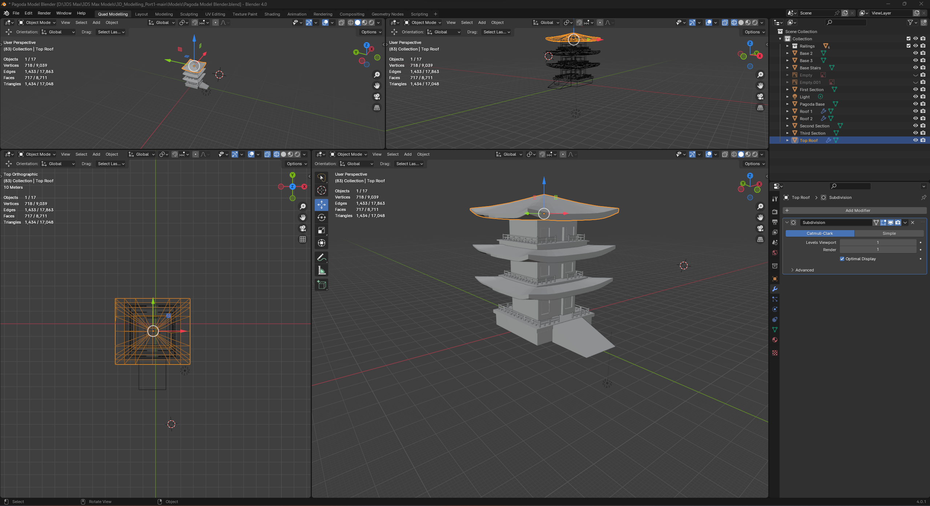
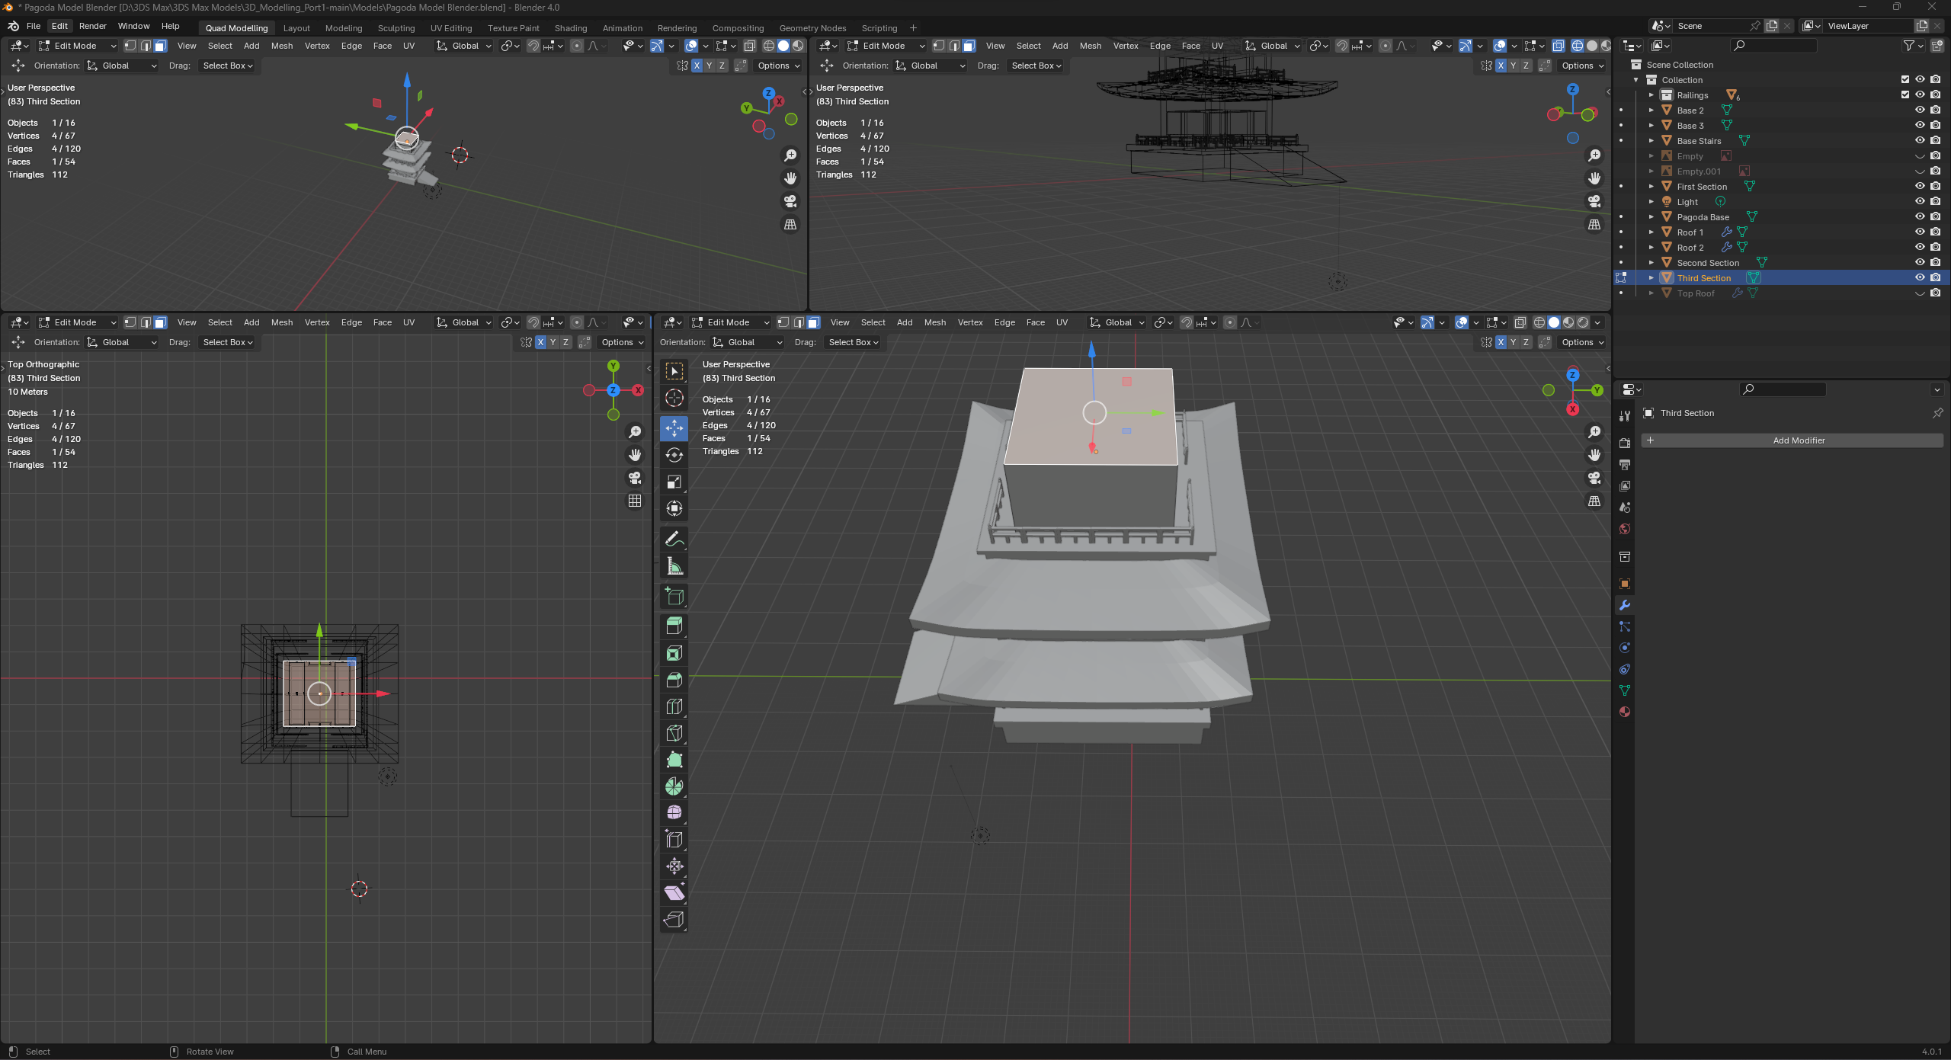
3D Modelling a Pagoda Part 5
As a pagoda is multi tiered the final step was only to correctly duplicate the previous layer and stack it on top to make a sufficiently large structure. I ended up stopping at three layers as anymore would have taken far too many polygons. After Duplicating my layers there were still two things I needed to do before I was done modelling. I first needed to alter my roof section on the topmost layer as this layer was the final one it needed to have a greater slope and size as nothing would be sitting on top of it weighing it down unlike my other roof sections below.to do this I simply extruded the center section and used the shrink/fatten tool to taper the top into a small peak to achieve a more pyramid like roof structure. The final thing I needed to do was to delete any unnecessary faces some faces like the one seen highlighted in my final screenshot were totally obscured by other parts of the model and were thus not visible in game either so to avoid having to render a bunch of additional polygons that would never be seen by anyone I went through and deleted all of these faces throughout my models to ensure only what was needed was being rendered at any given time.

Slide 7
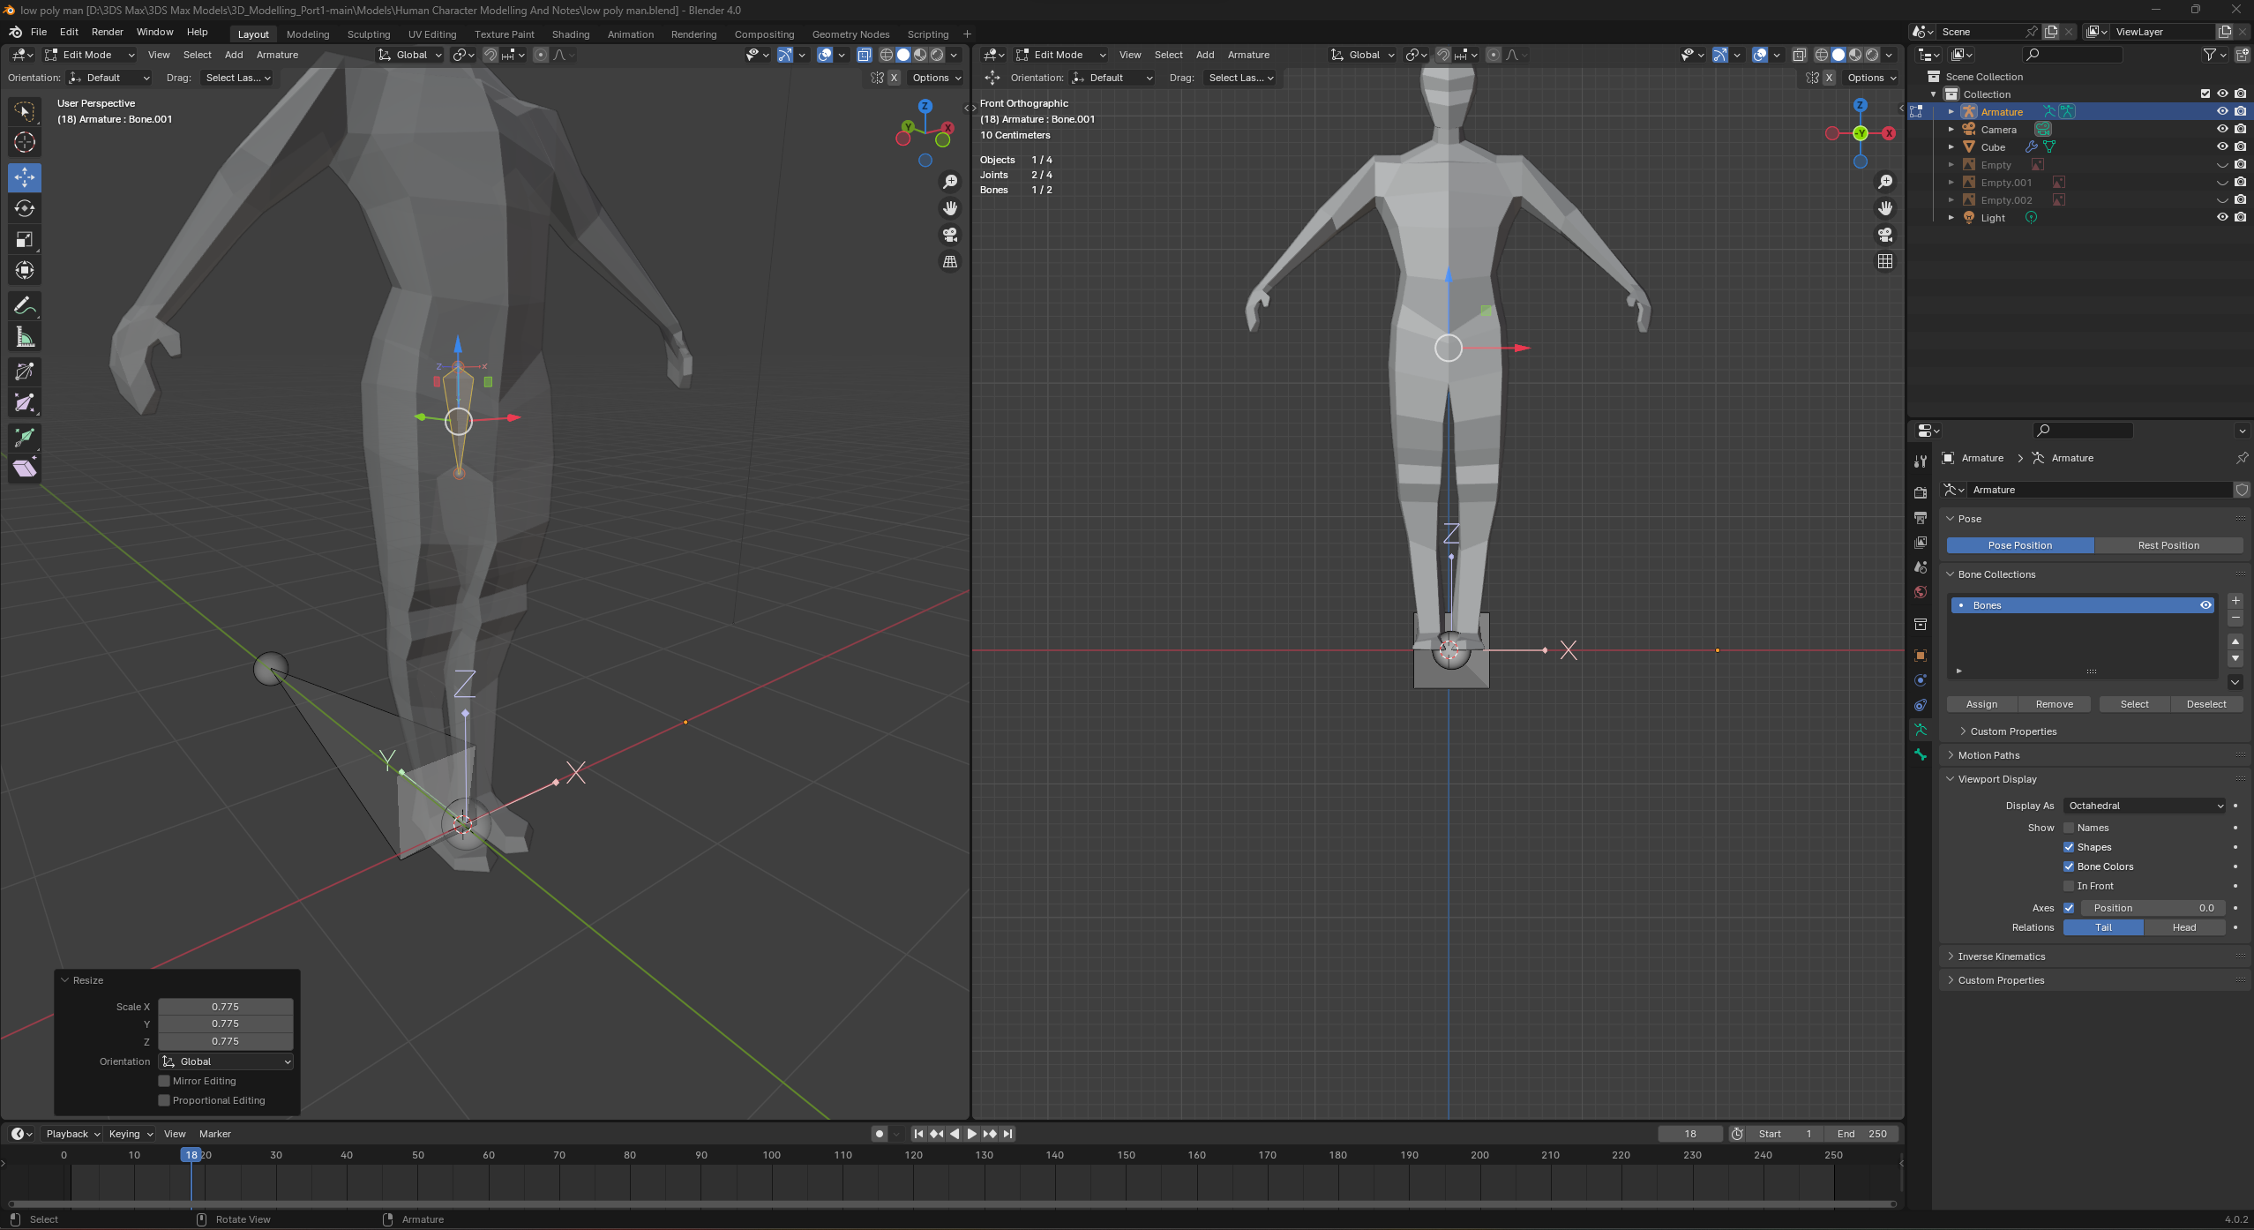
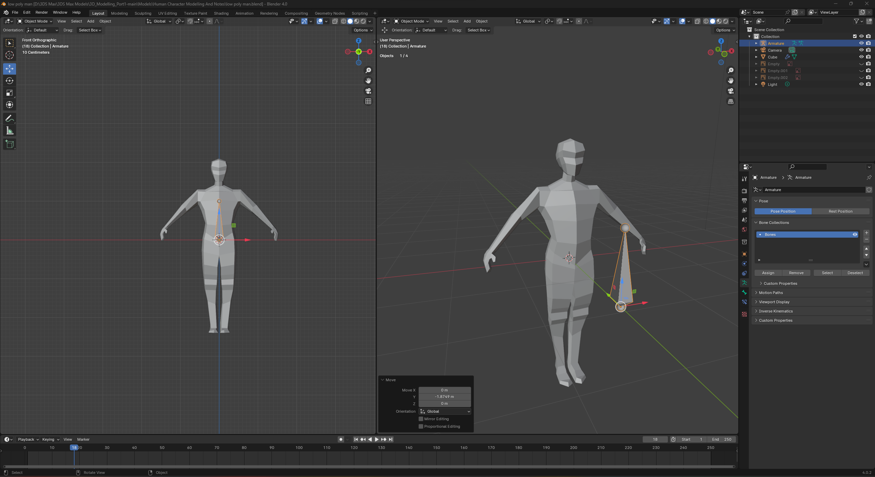
Animating And Rigging Part 1
Here you can see my character model which I have begun the process of rigging using and armature and bones in Blender. The first step I took was to create a bone and line it up with the world origin to create a root which the characters bones would be anchored with

Slide 8
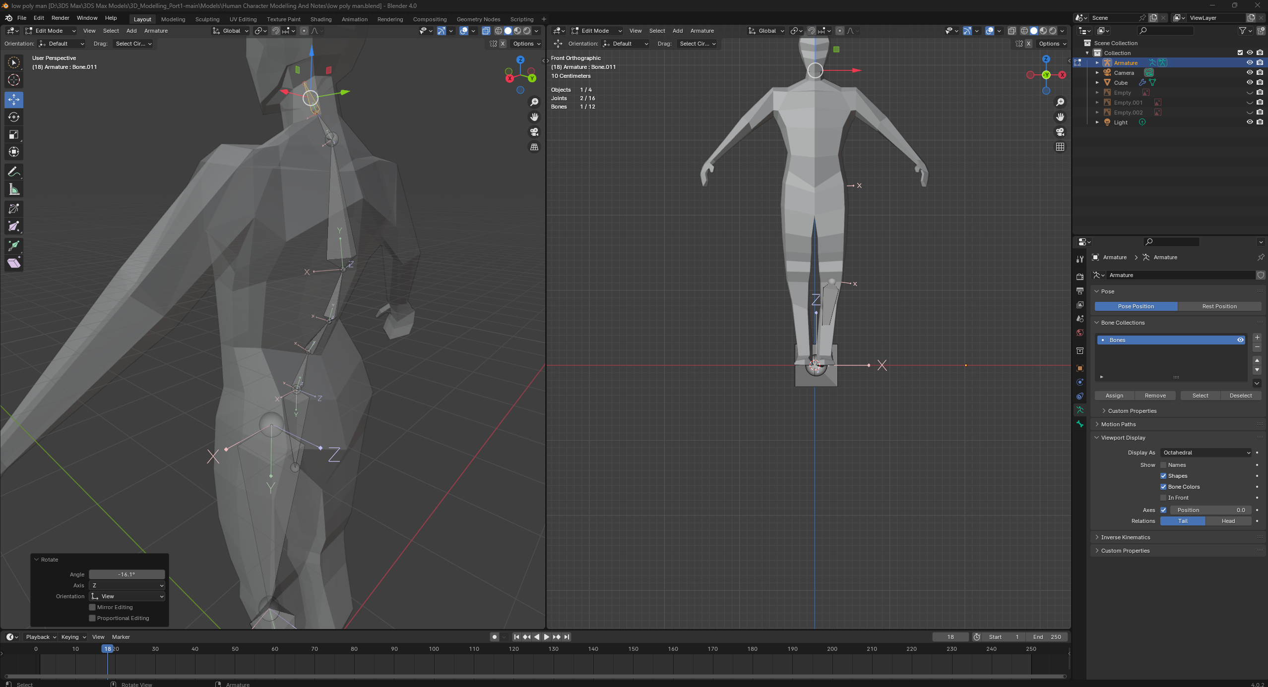
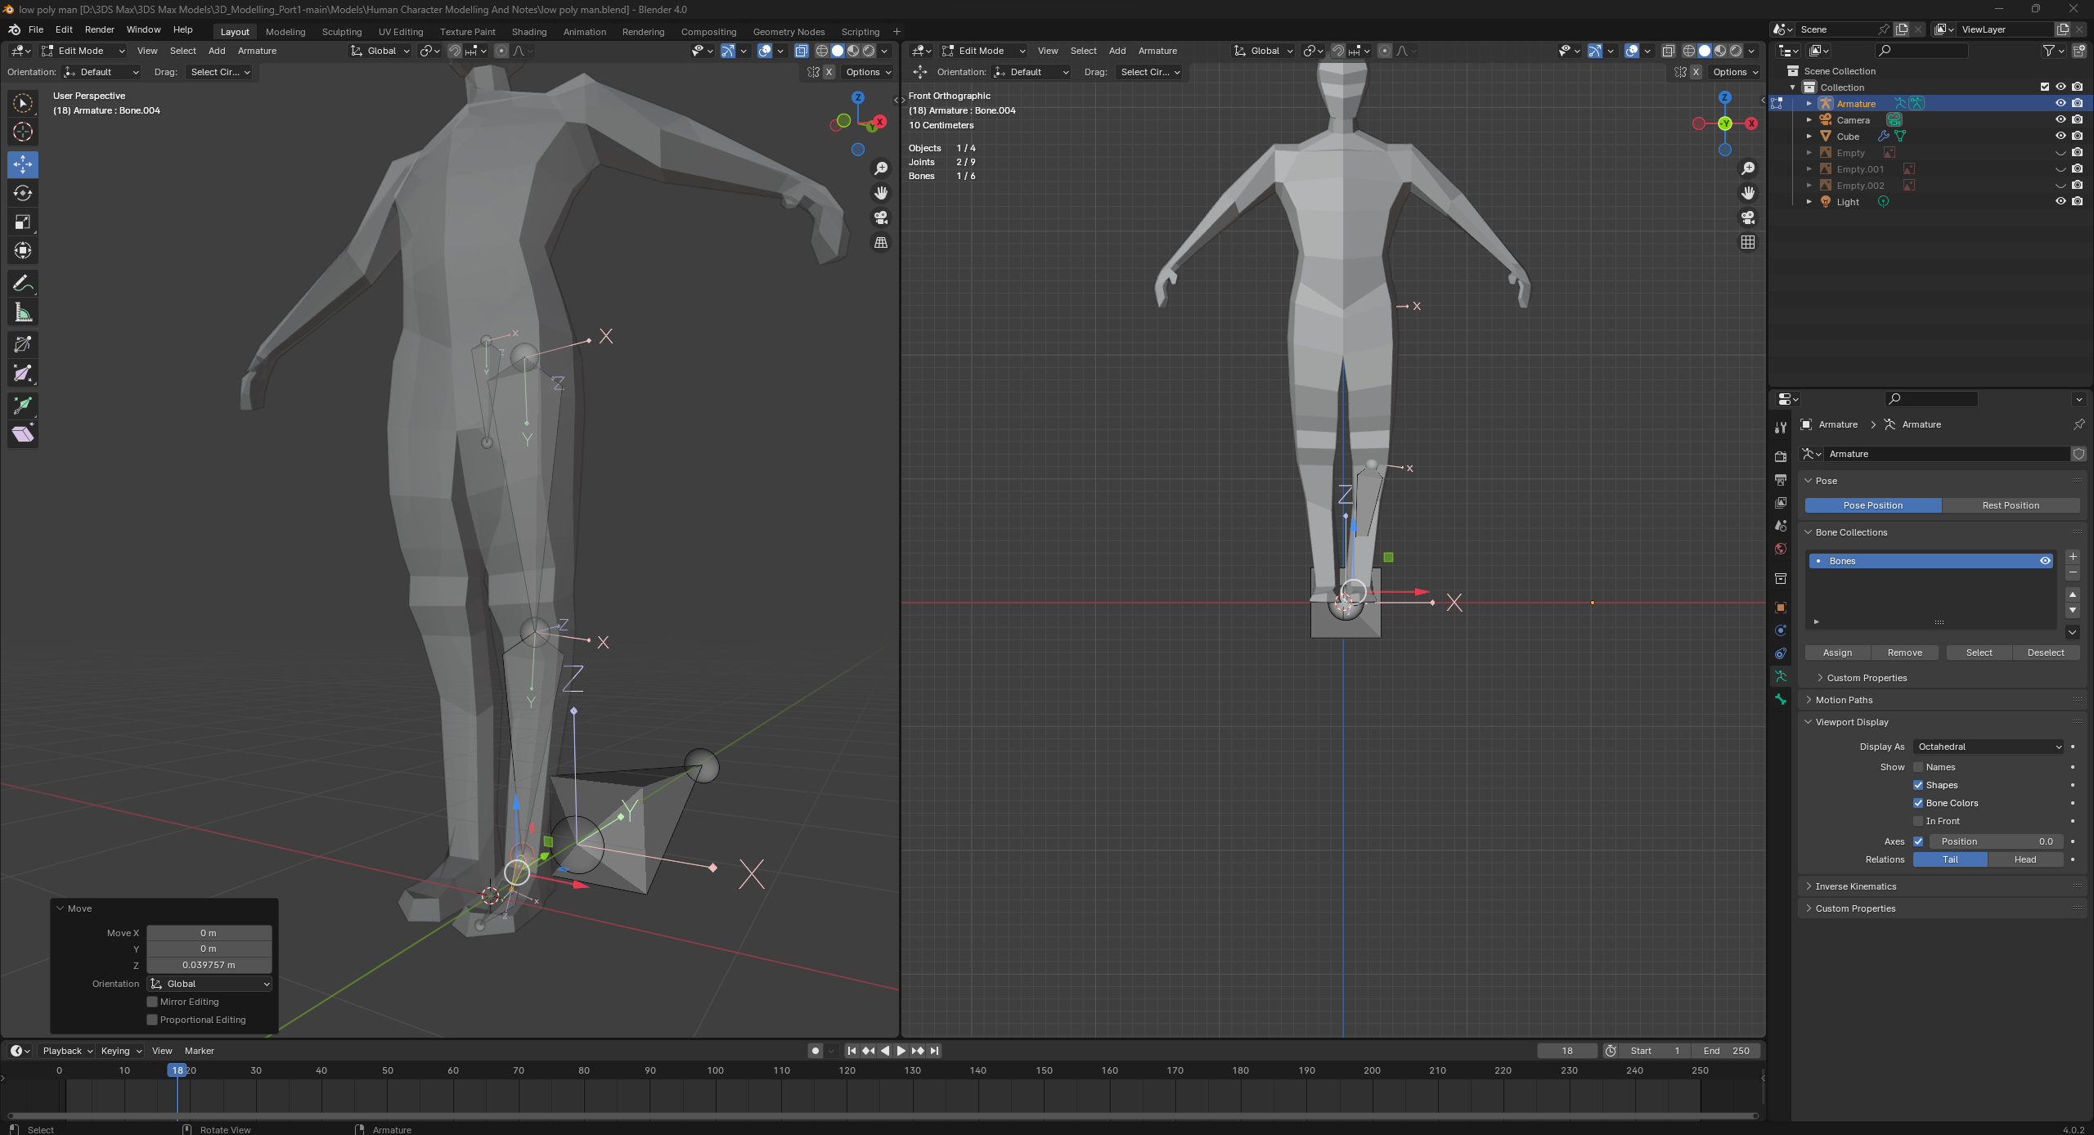
Animating And Rigging Part 2
In this second part you can see me adding additional bones throughout my character model. Starting with the central hip bone i extruded out a number of bones to create a basic representation of a human skeletal system you can see where bones have been placed to allow human like movement. In some areas like the lower part of the back where the end of the spine and coccyx would be I have added a greater number of smaller bones which allow for a greater degree of fine movement whereas for more stiff or limited areas such as the upper leg / thigh I have opted for much longer single bones to better represent how these body parts would move in real life

Slide 9
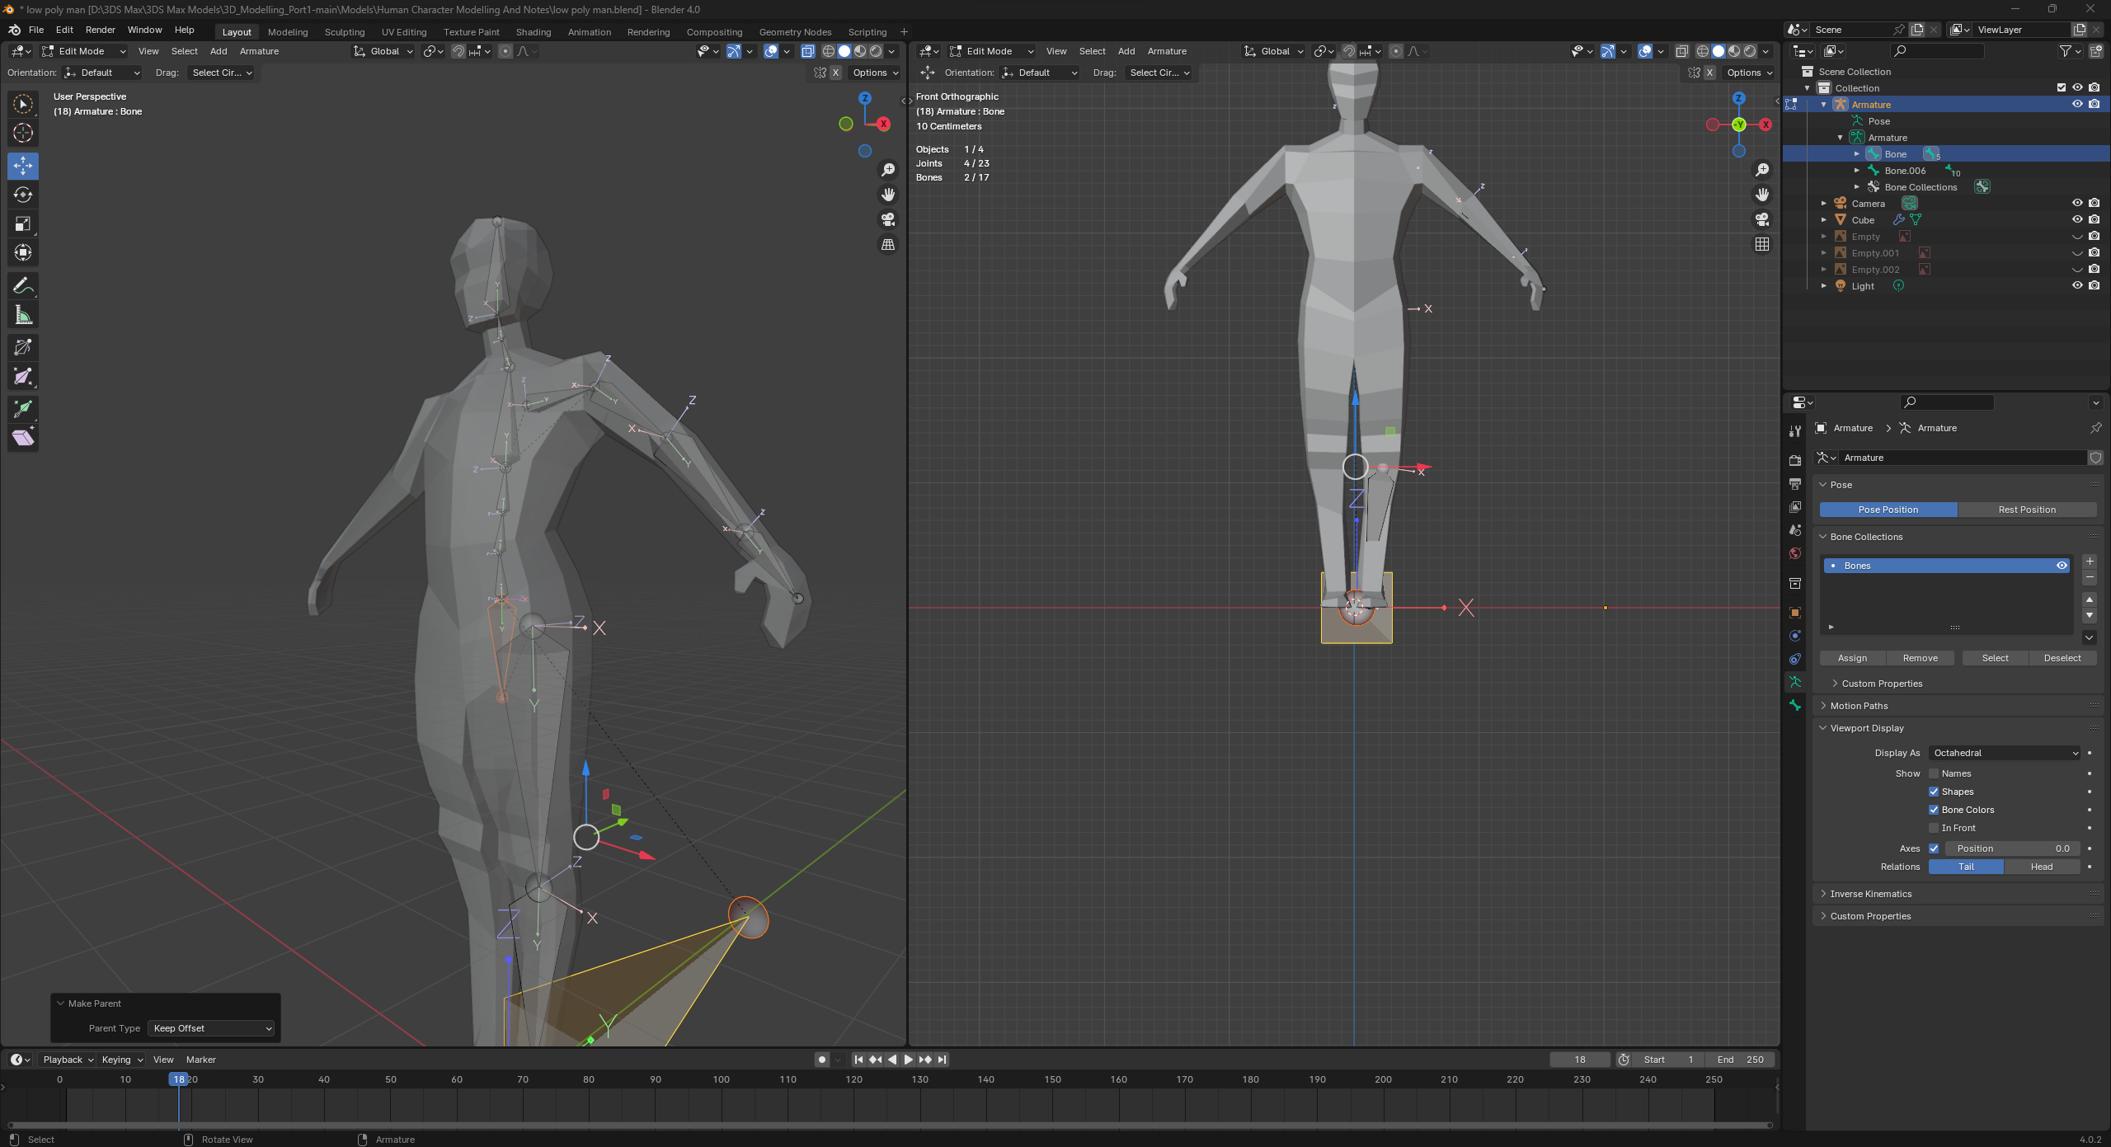
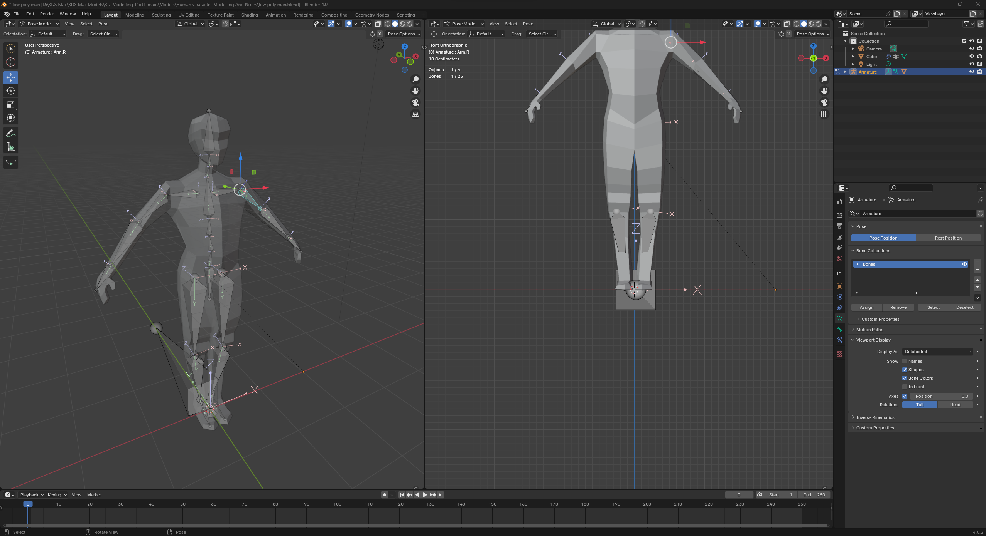
Animation and Rigging Part 3
At this stage I was beginning to link certain bone groups together with the keep offset modifier to link their movements and positions together. After applying my offset modifier I went back into object mode and selected both my mesh and my armature to apply the “automatic weights” setting to them allowing me to skin my mesh and bind it to the bones so that when my bones move the mesh will move and change around it to account for those movements.

Slide 10
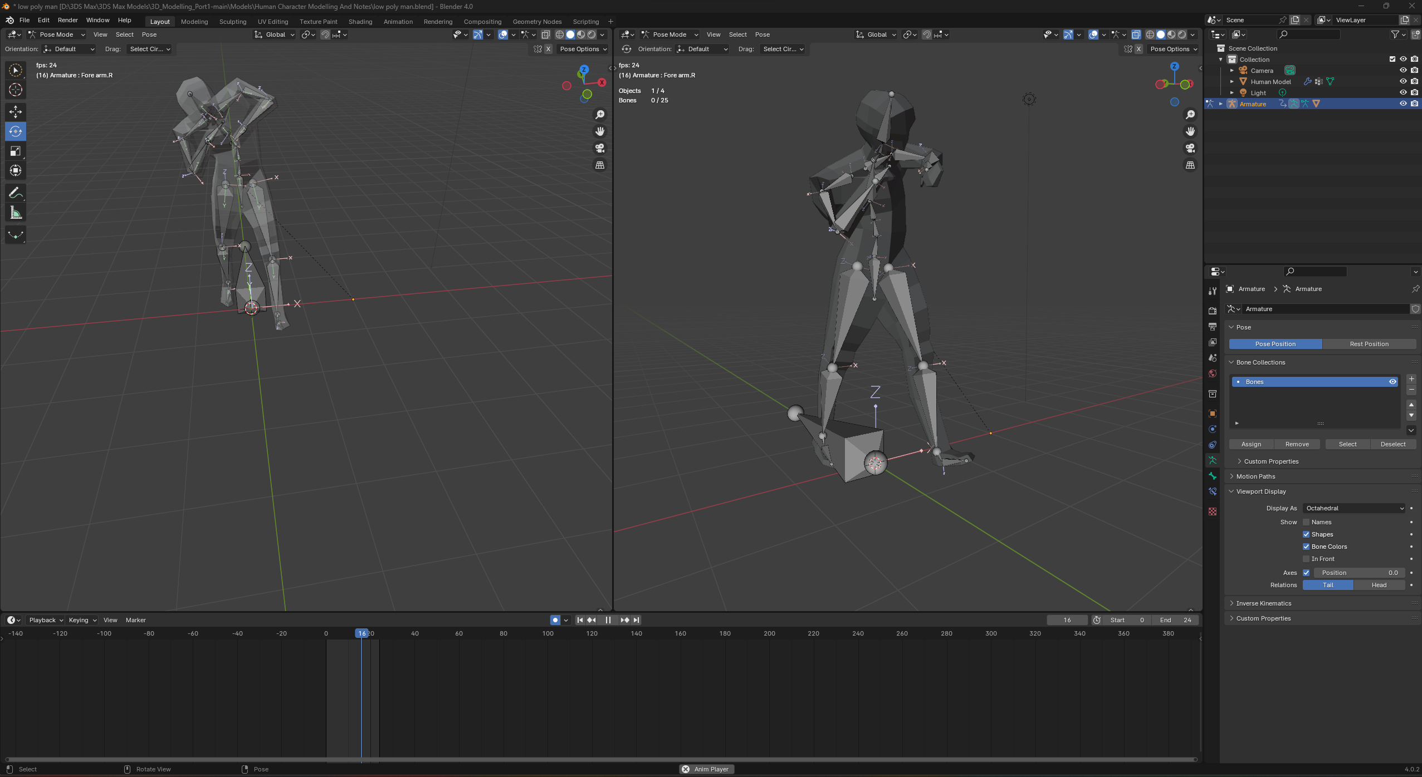
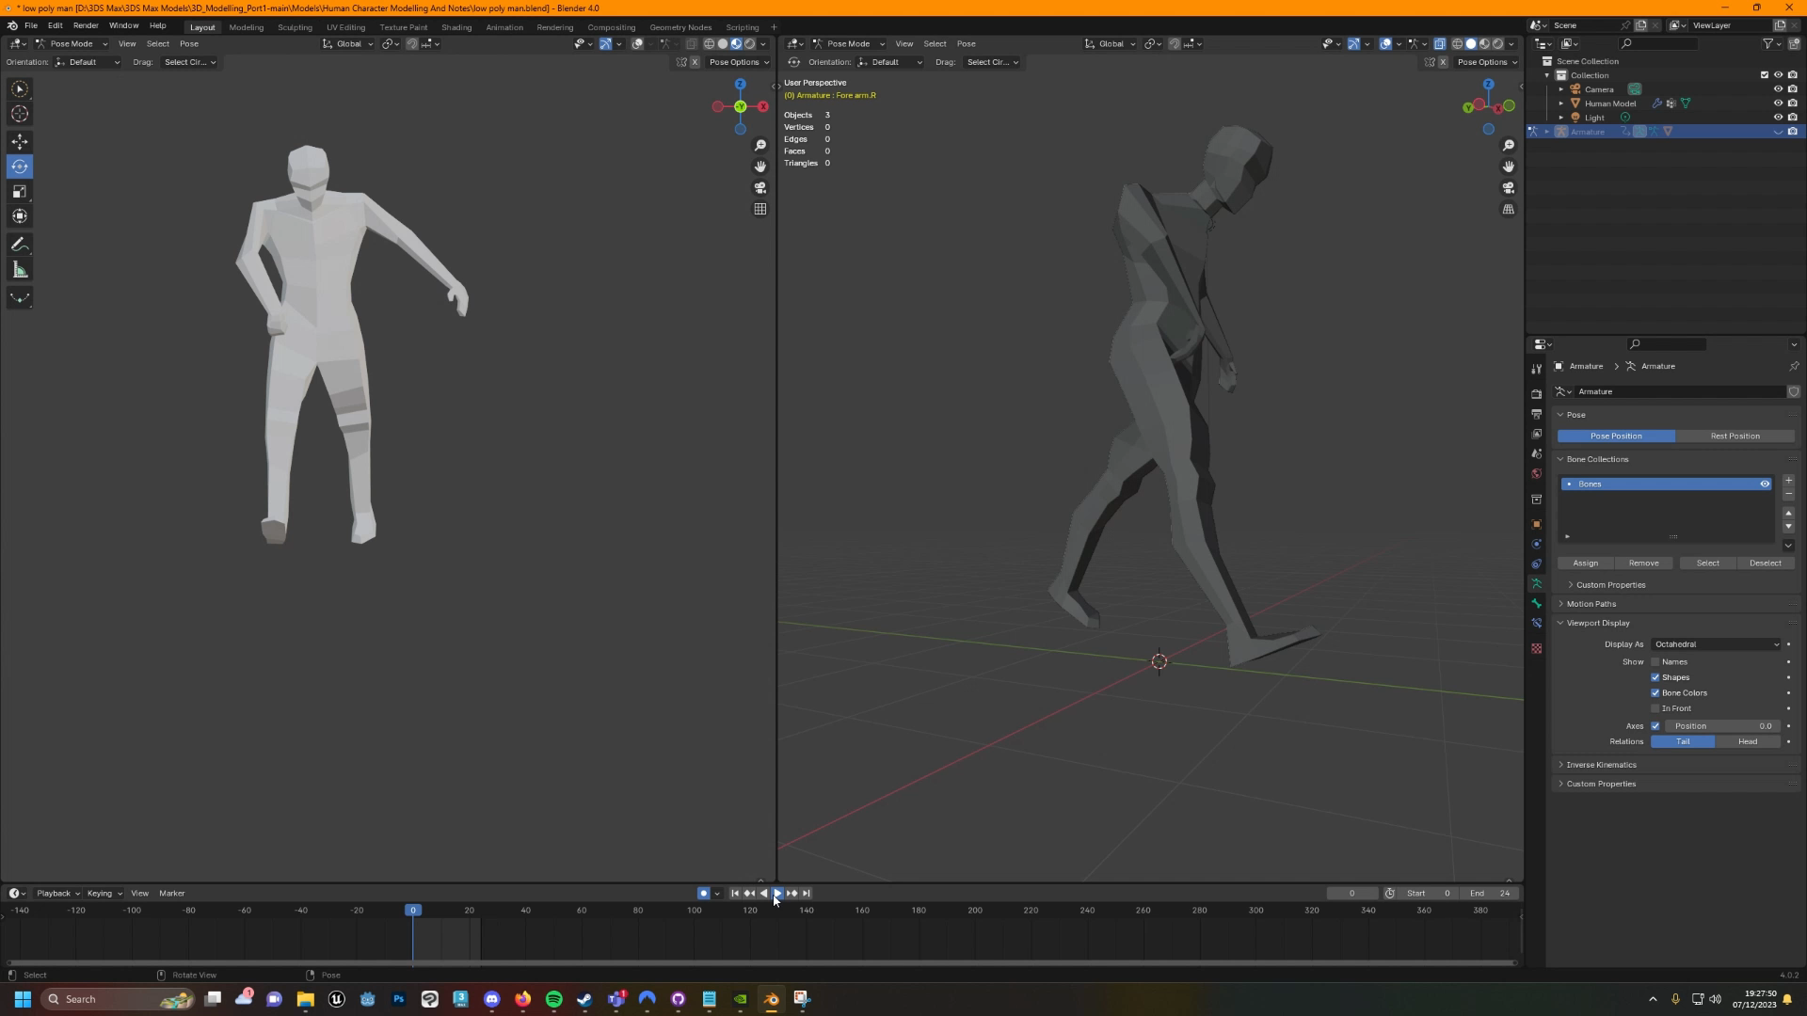
Animation And Rigging Part 4
After successfully rigging my character, I decided to make a small animation loop that would demonstrate the use of multiple limbs simultaneously using my bones and the animation tools provided in the pose editor section in blender. Using the animation timeline, I was able to capture several different moments with keyframes to then save and be able to play back as an animation which can be previewed in the video attached to this slide

Slide 11
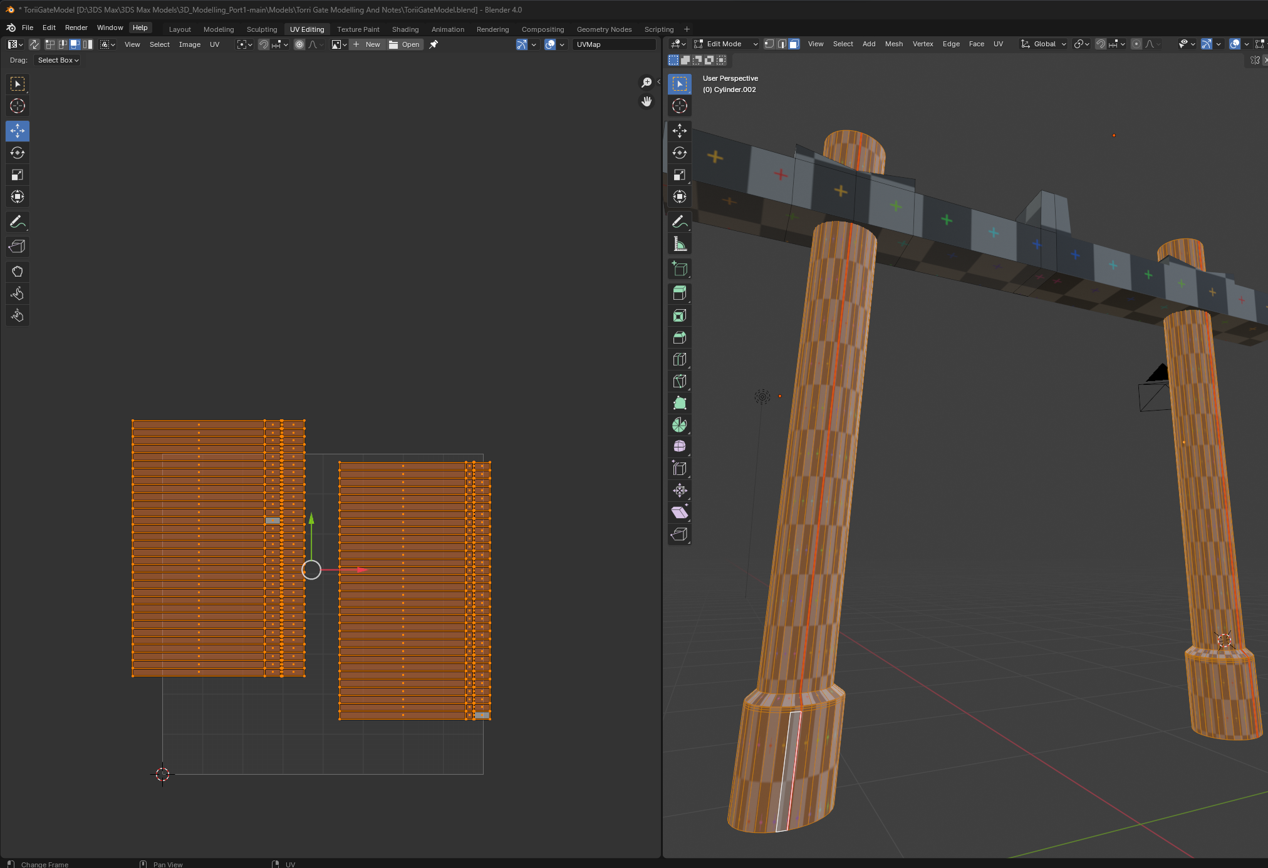
UV Unwrapping And Texture Creation Part 1
The first stage in texturing a 3D model is to do a UV unwrap this allows us to map how are textures are applied to our model when we come to that stage. There's a variety of different methods for UV unwrapping objects in blender but here I opted for the more manual approach of directly marking “seams” in parts of my model to tell blender how I wanted different parts of my model unwrapped. In the screenshot next to this you can see how I've unwrapped two pillars in my Torii Gate model by defining one continuous seam along one edge of my cylinder it allows me to unwrap in one continuous shape. After unwrapping all of my UV’s I then proceed to scale them all to fit into my texture space while making the best use of my UV space possible

Slide 12
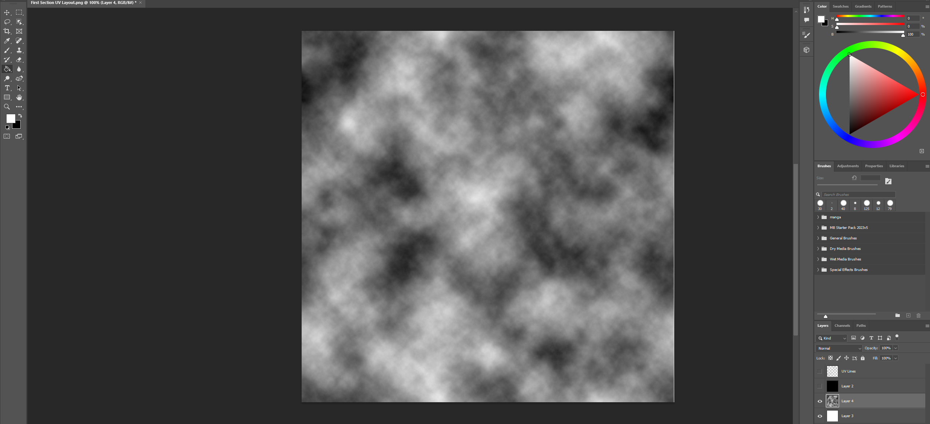
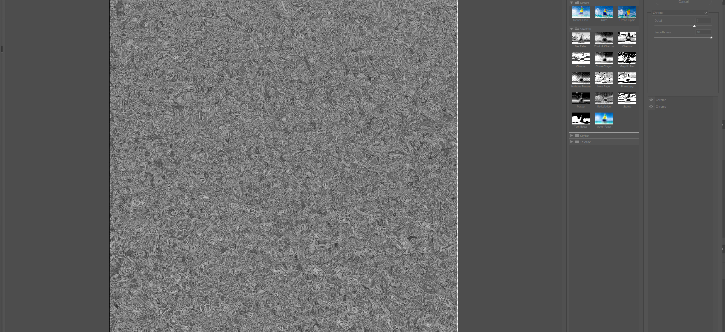
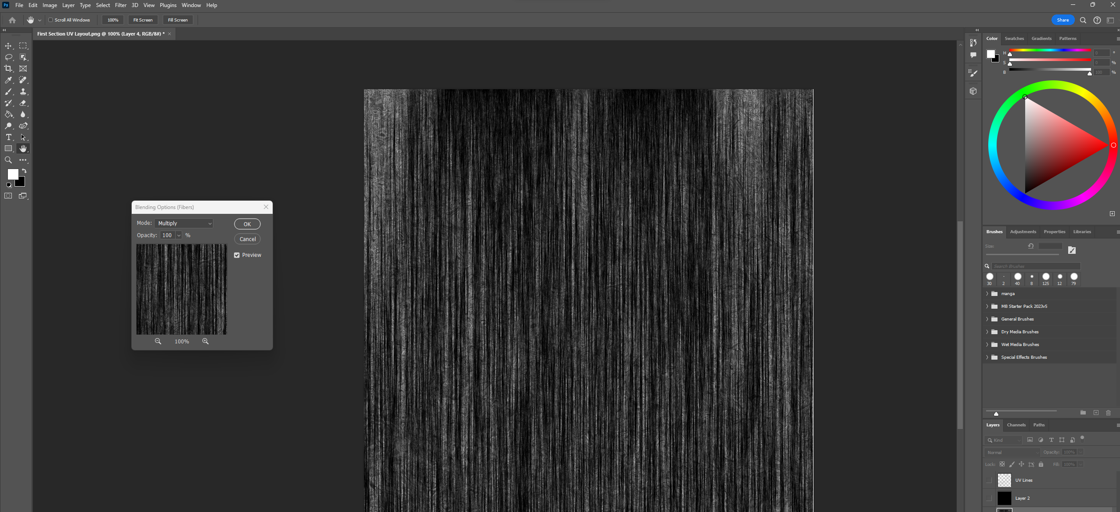
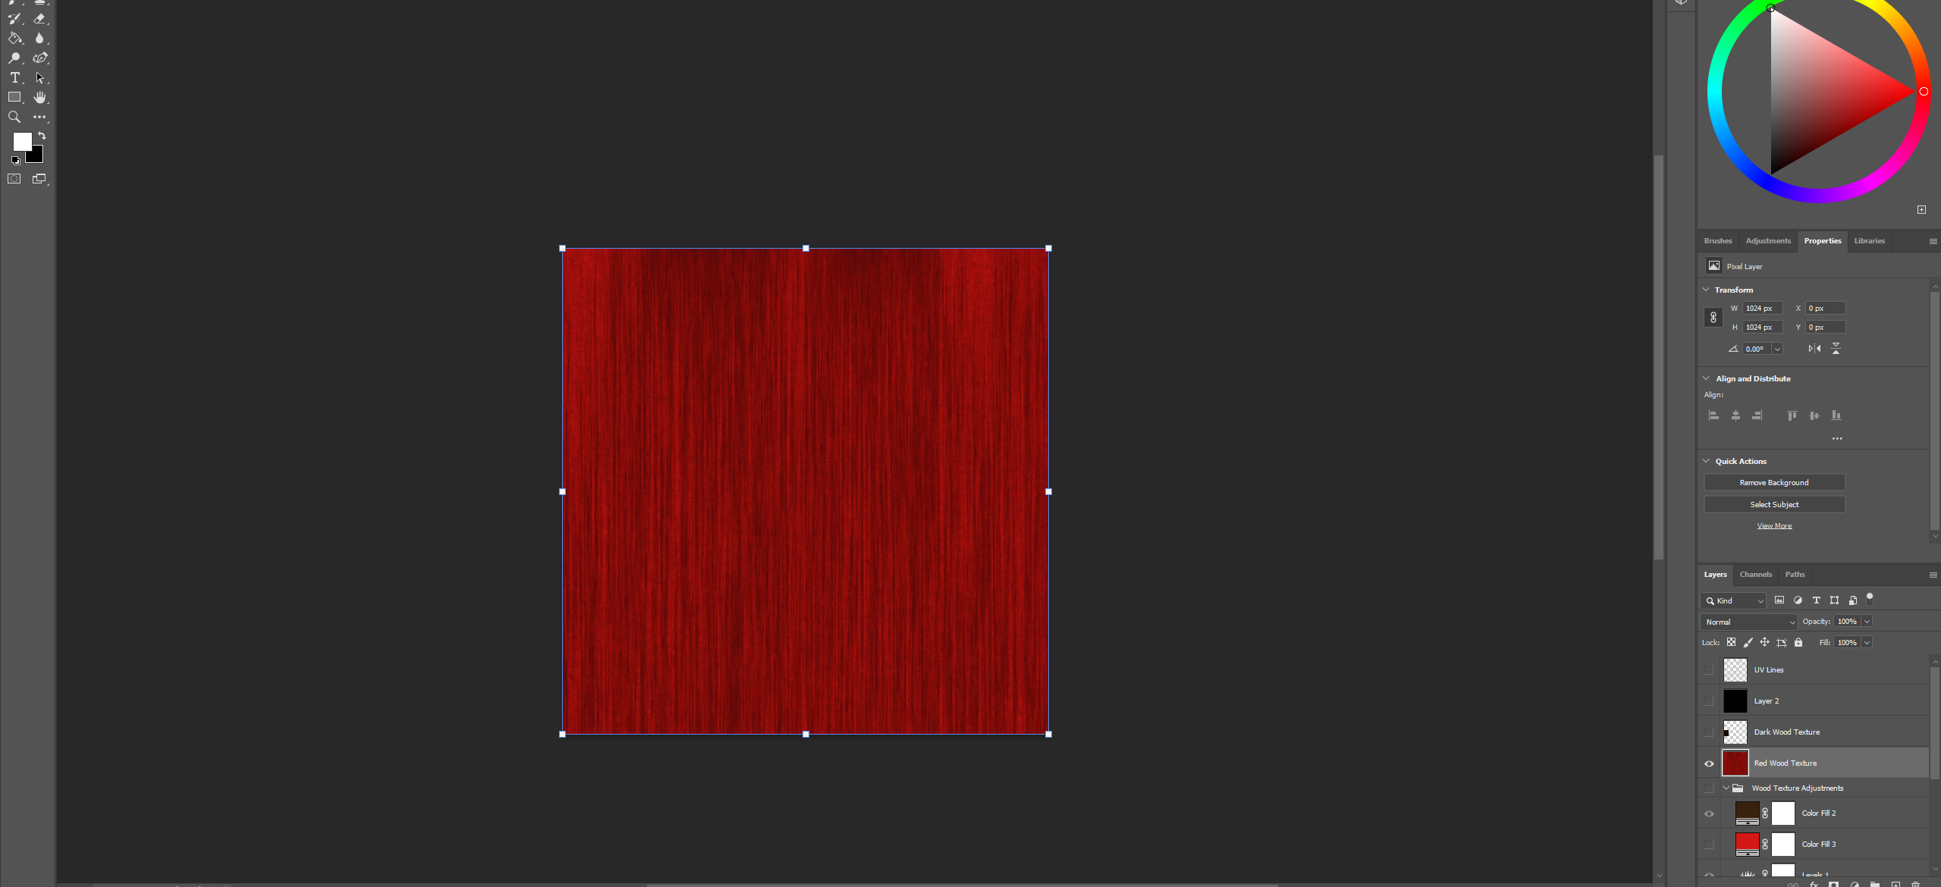
UV Unwrapping And Texture Creation Part 2
In the following screenshots you can see the process of creating a wooden texture all made with photoshop. This is a texture I've used in multiple of my models within this portfolio. I started by adding render clouds to the canvas to fill the scene with some contrast which I could work with. Then I applied a chrome filter on top of my render clouds to give an organic flowing texture which was then stretched out using a “fibers” rendering effect to create a continuous wood grain type of effect. And finally, I added a colour layer and set the blending mode to “multiply” to apply any desired colour on top of my wooden grain texture which I then used to make a variety of different colored wood effects for my diffuse maps. A similar process was also used to create all of the various textures you can see in my models

Slide 13
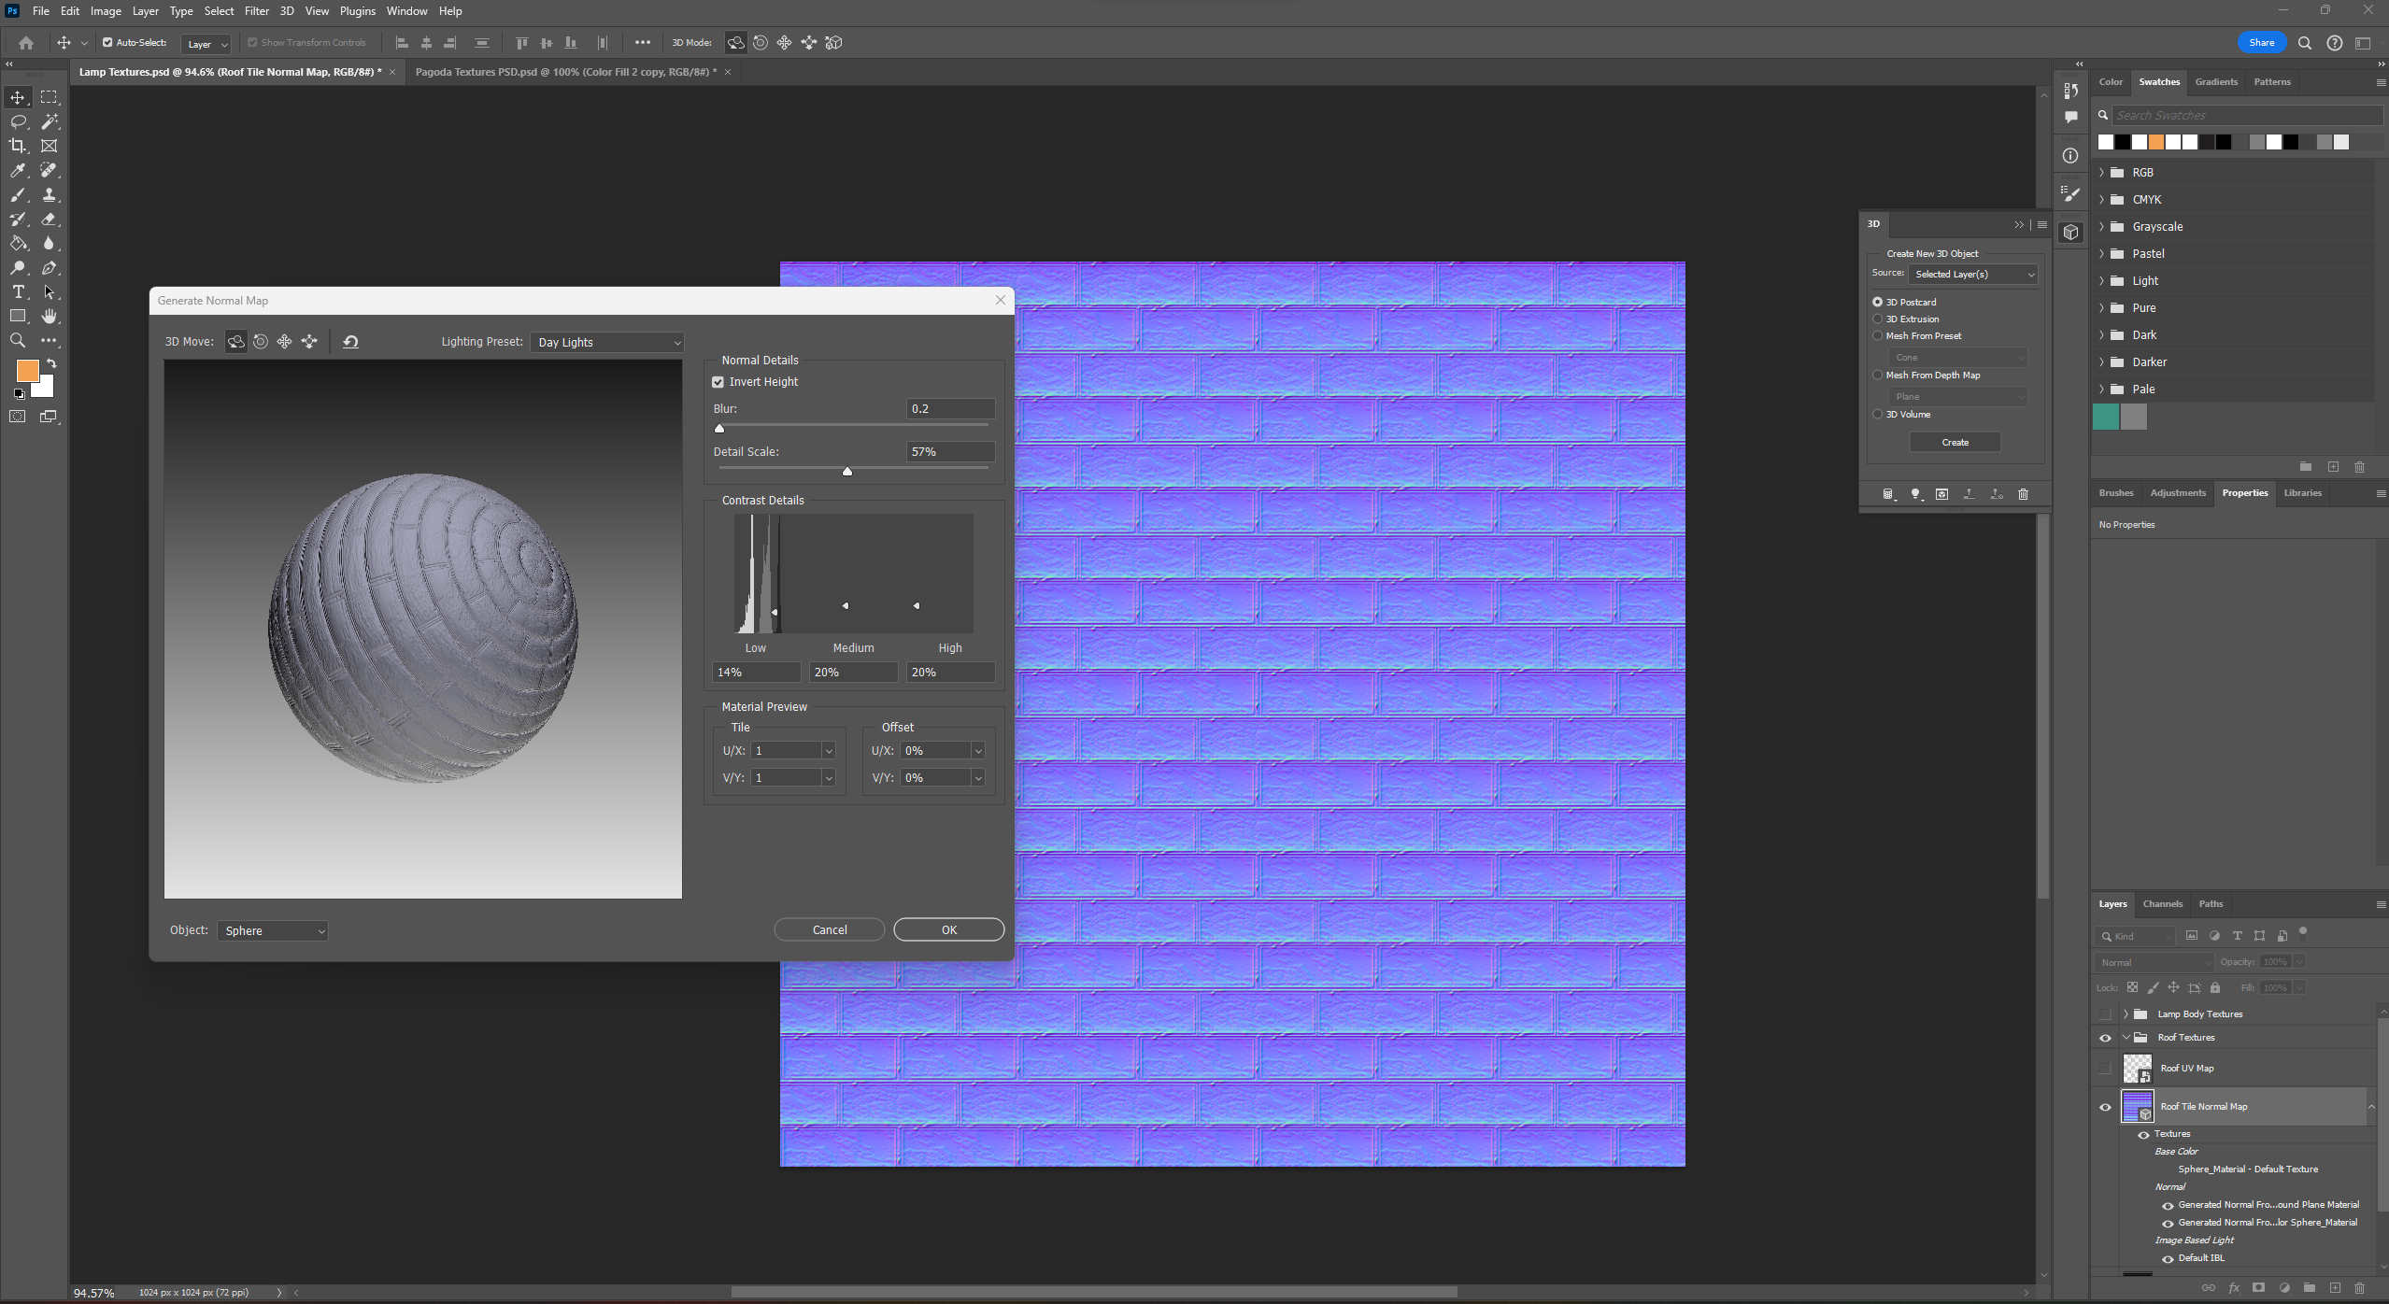
UV Unwrapping And Texture Creation Part 3
In this slide you can see the process of generating normal maps that I used for my models. In this screenshot I was generating a normal map from my brick texture to attempt to give it a more 3D look which would allow me to save on time and polygons by creating an illusion of depth by adjusting the way light is bounced off my model. When generating normal maps, I would use photoshop to create and adjust the detail and blur levels of all my maps which would then be exported and applied to my models as an image file.

Slide 14
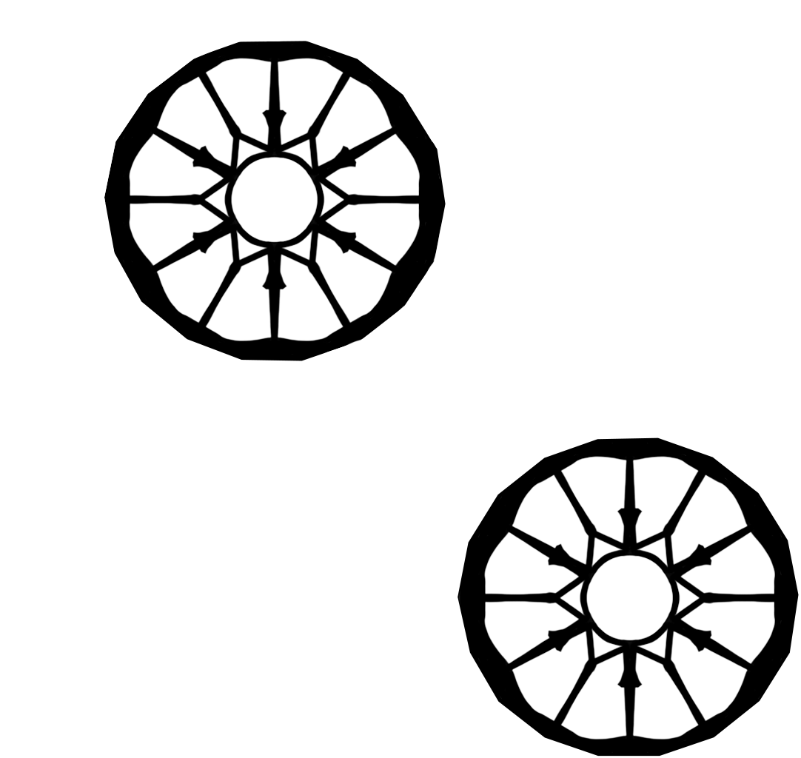
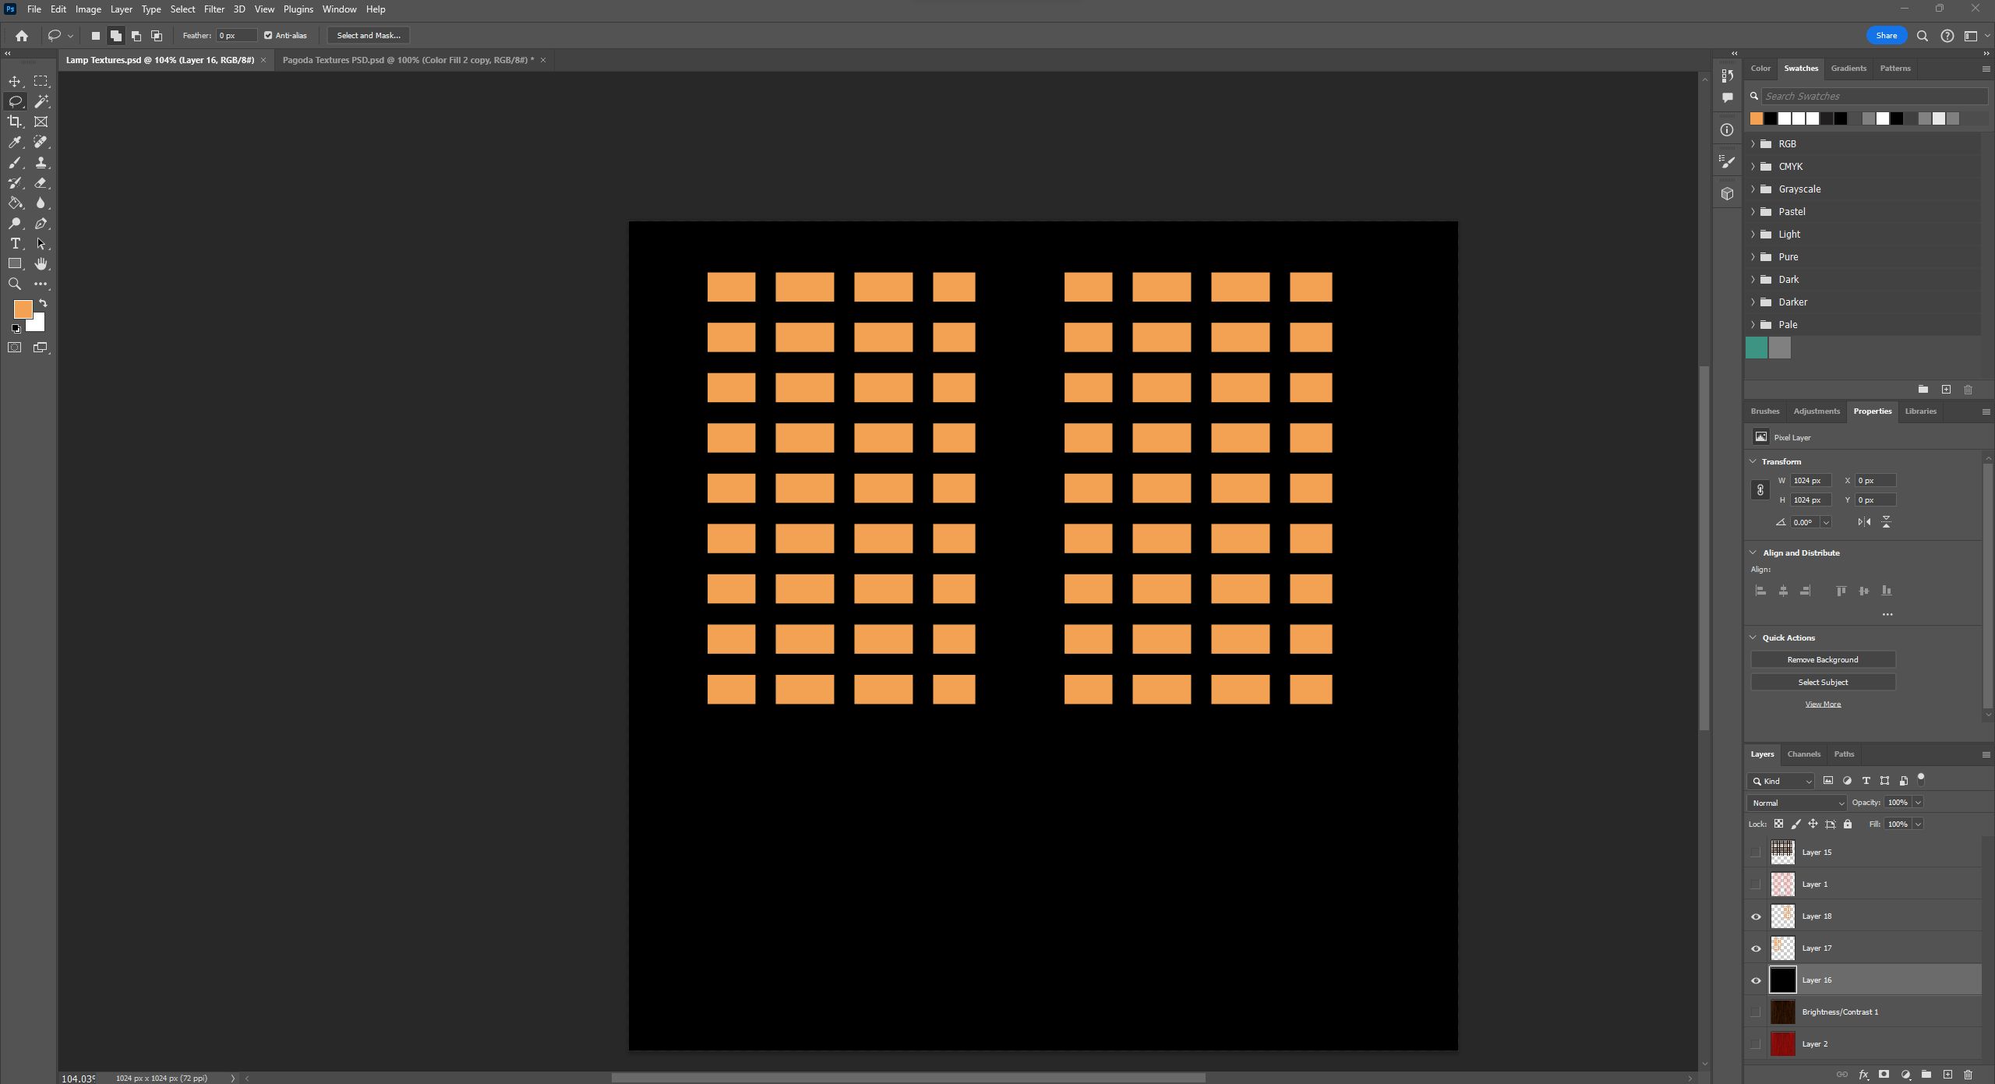
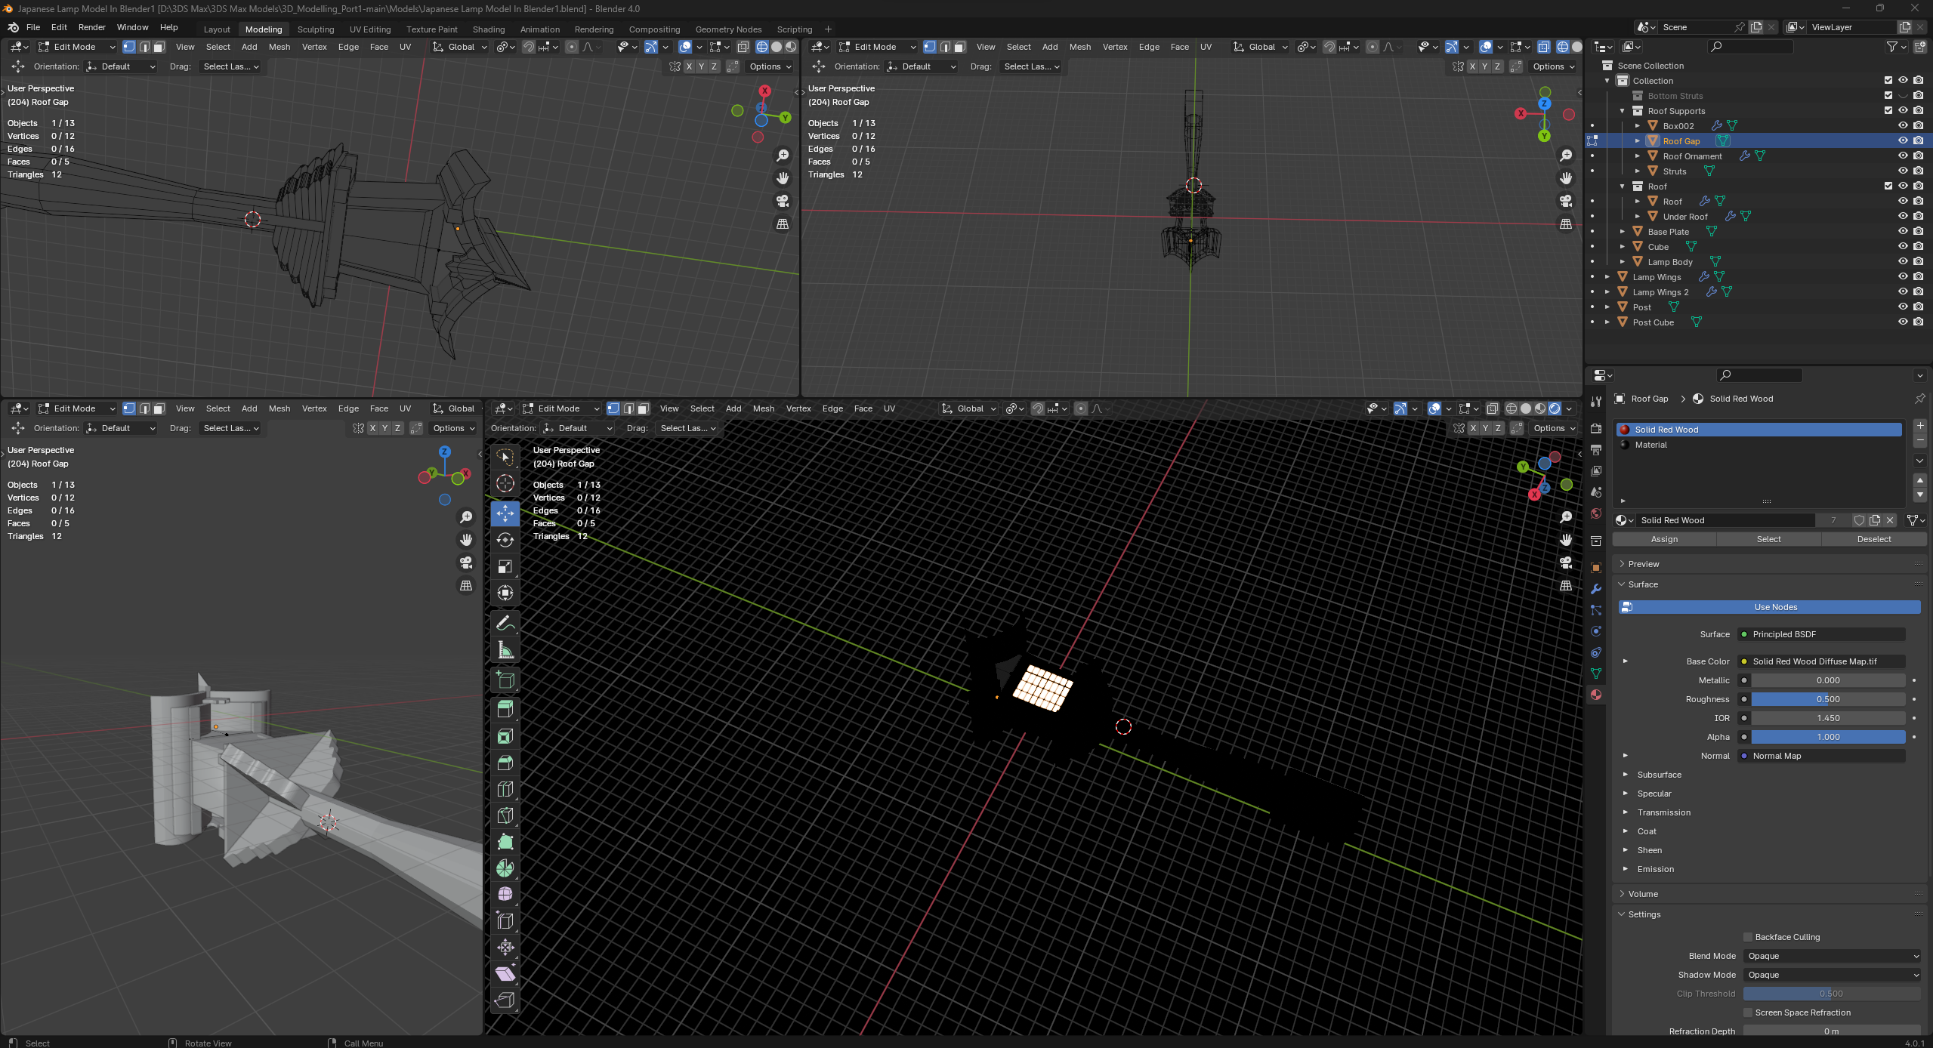
UV Unwrapping And Texture Creation Part 4
There were two other map types I created for some of my models. The transparency map which is the black and white image. This map was created for use in my katana model, but I never ended up using/applying it to my final rendition. The transparency map is quite simple int that everything that’s white is opaque and everything that’s black is 100% transparent with the shades of grey in-between being varying levels of transparency. My second map is the emission map which I created for my lamp model by taking my diffuse map and marking out the places I wanted to glow with a solid warm looking orange colour which was then applied to a black background. The emission map will apply a glowing emission effect to any colour applied to a black background so here it is responsible for the orange glow you can see emanating from my lamp when I switch to lighting mode in blender.

Slide 15
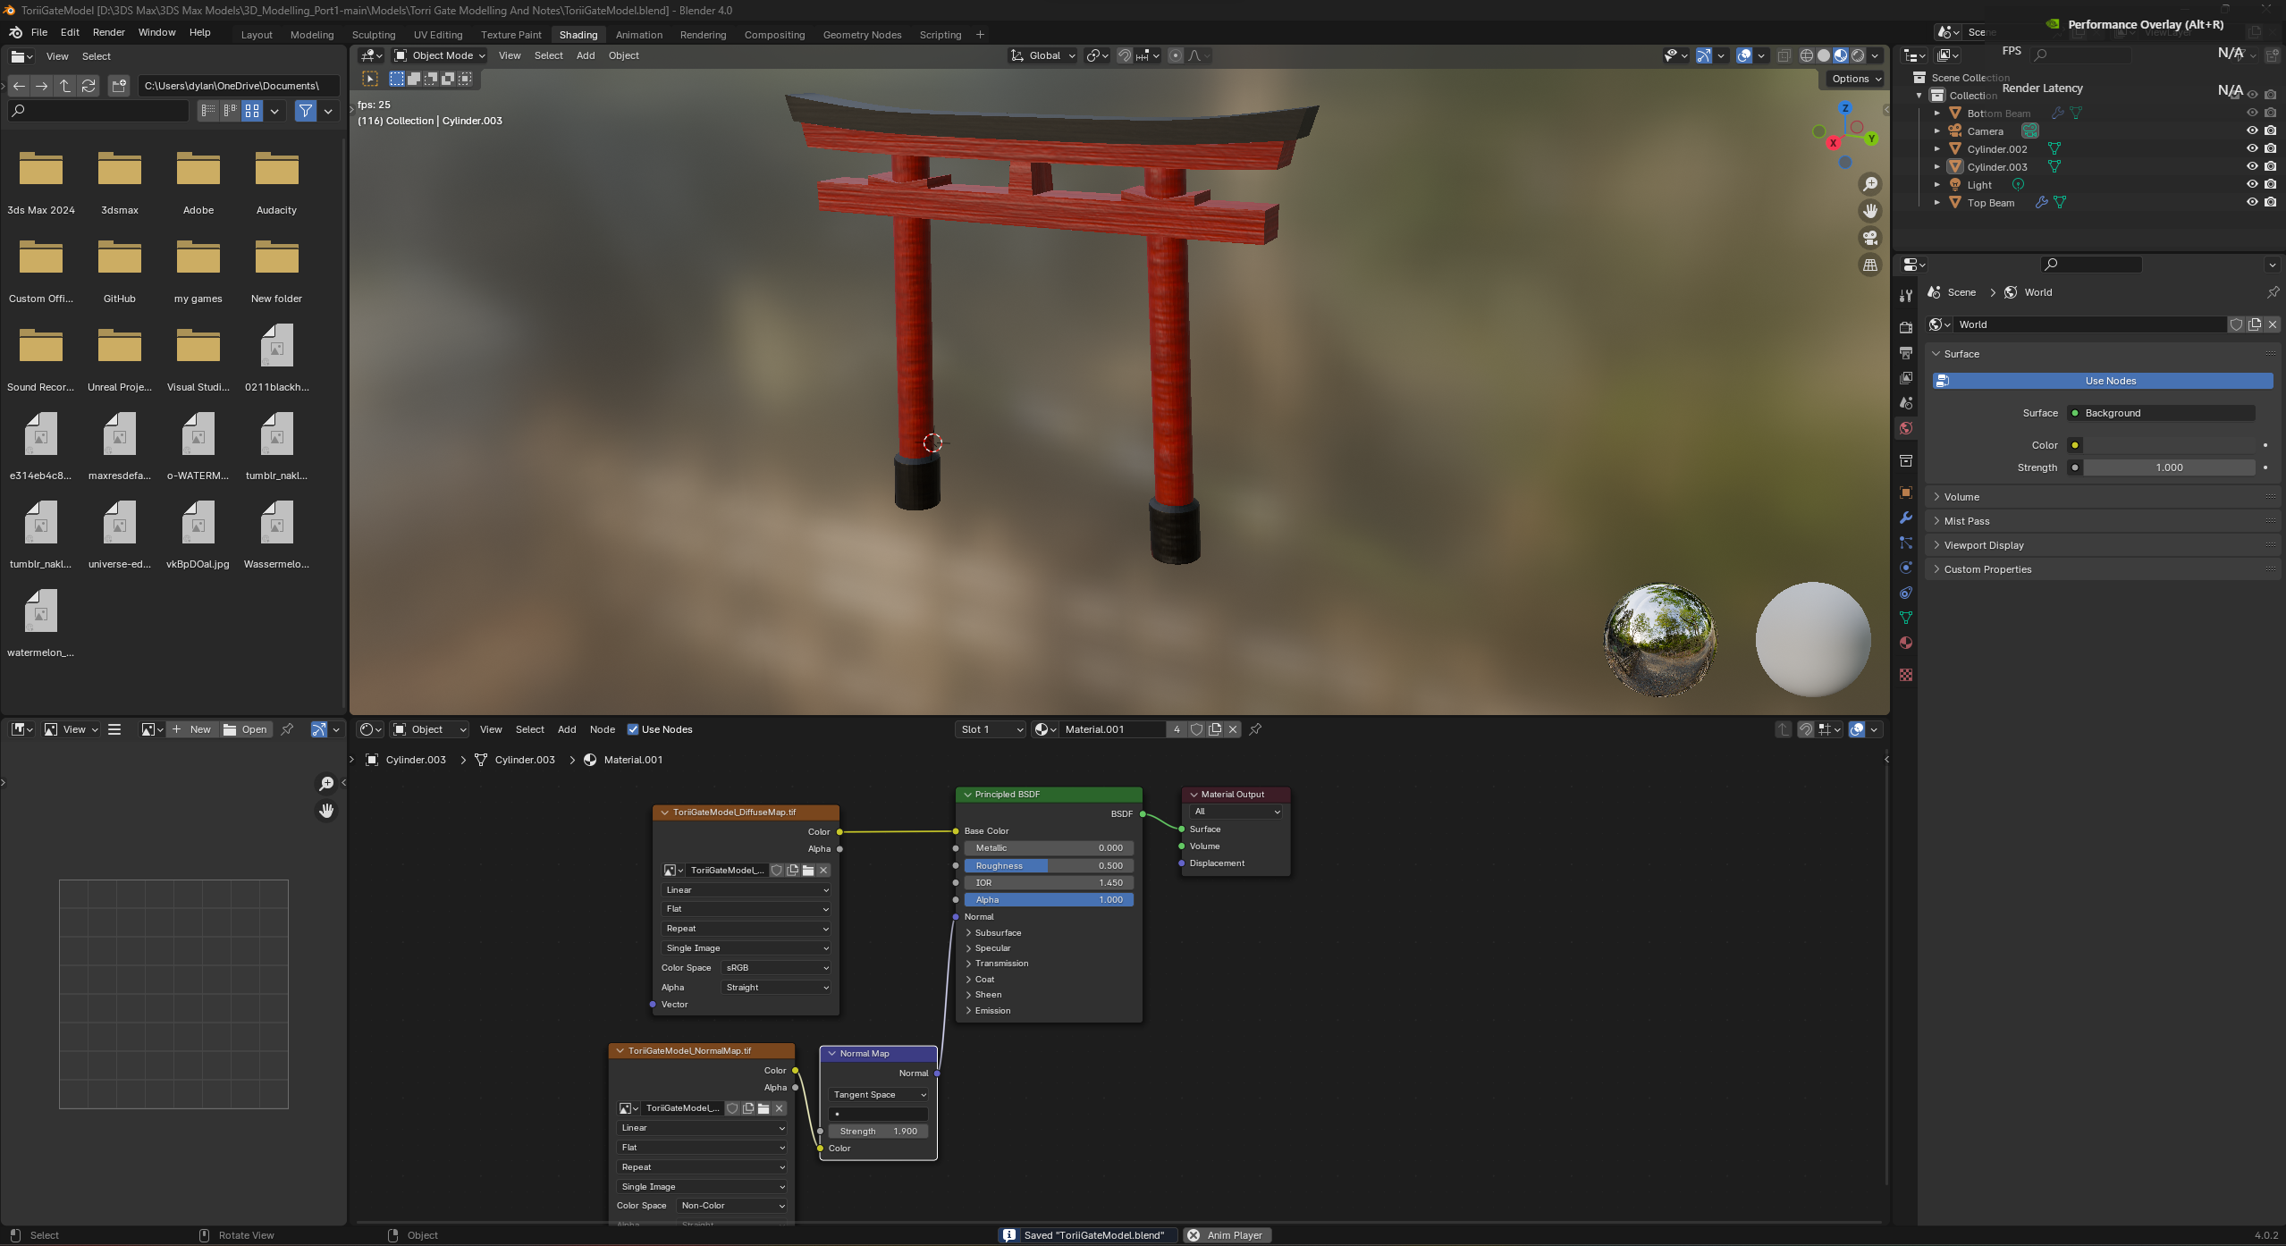
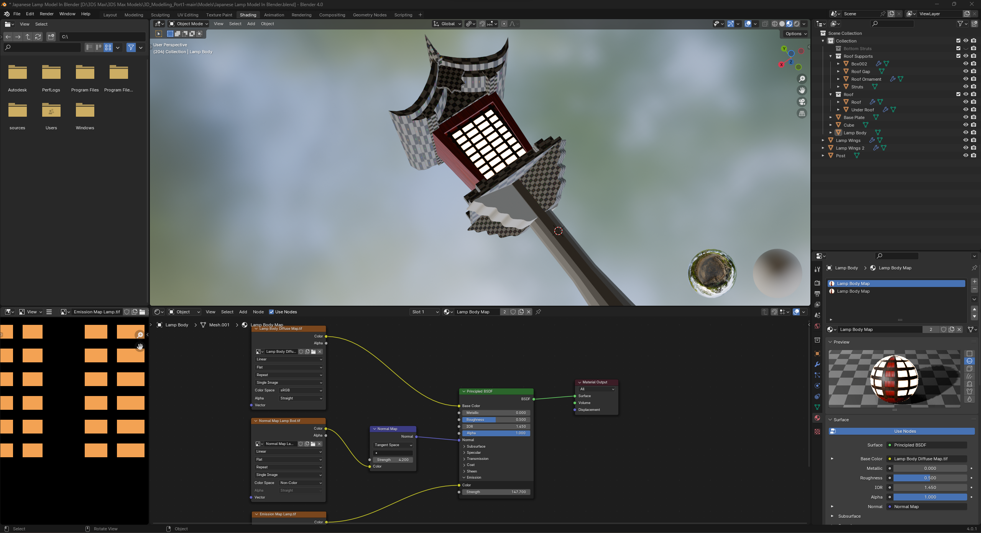
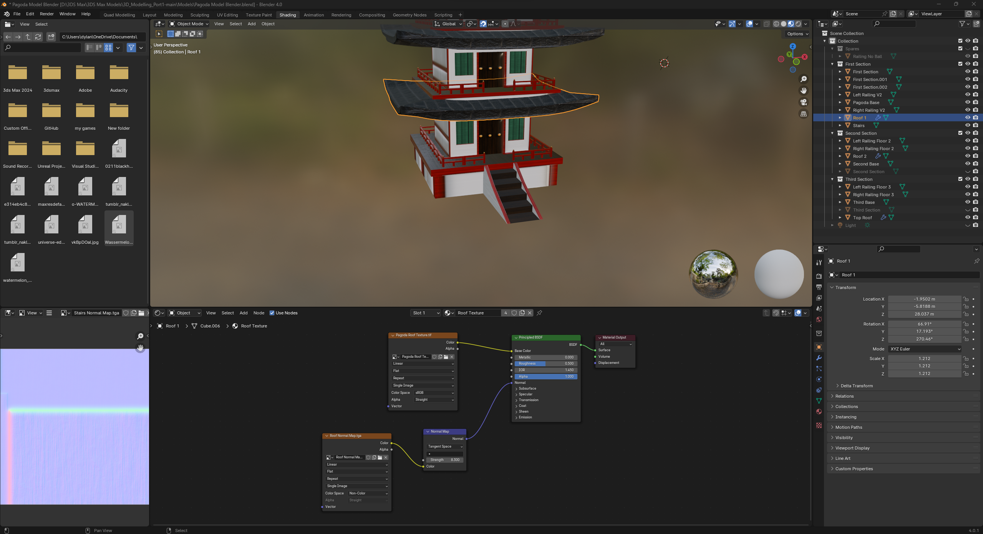
UV Unwrapping And Texture Creation Part 5
In this final stage I would take my maps and using the “shading” tab in Blender I would add my various maps as image nodes and route them into and through their respective slots on the material editor. These materials could then be applied to my model to give them their textures and various lighting and transparency effects

Slide 16
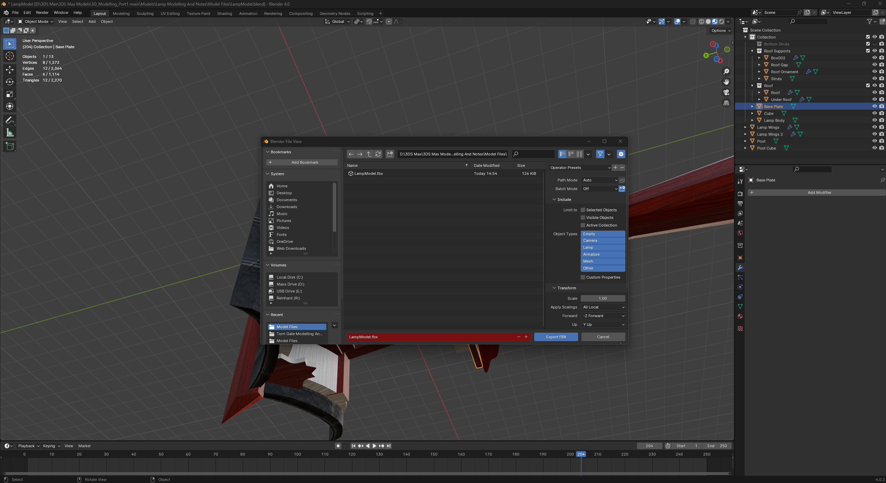
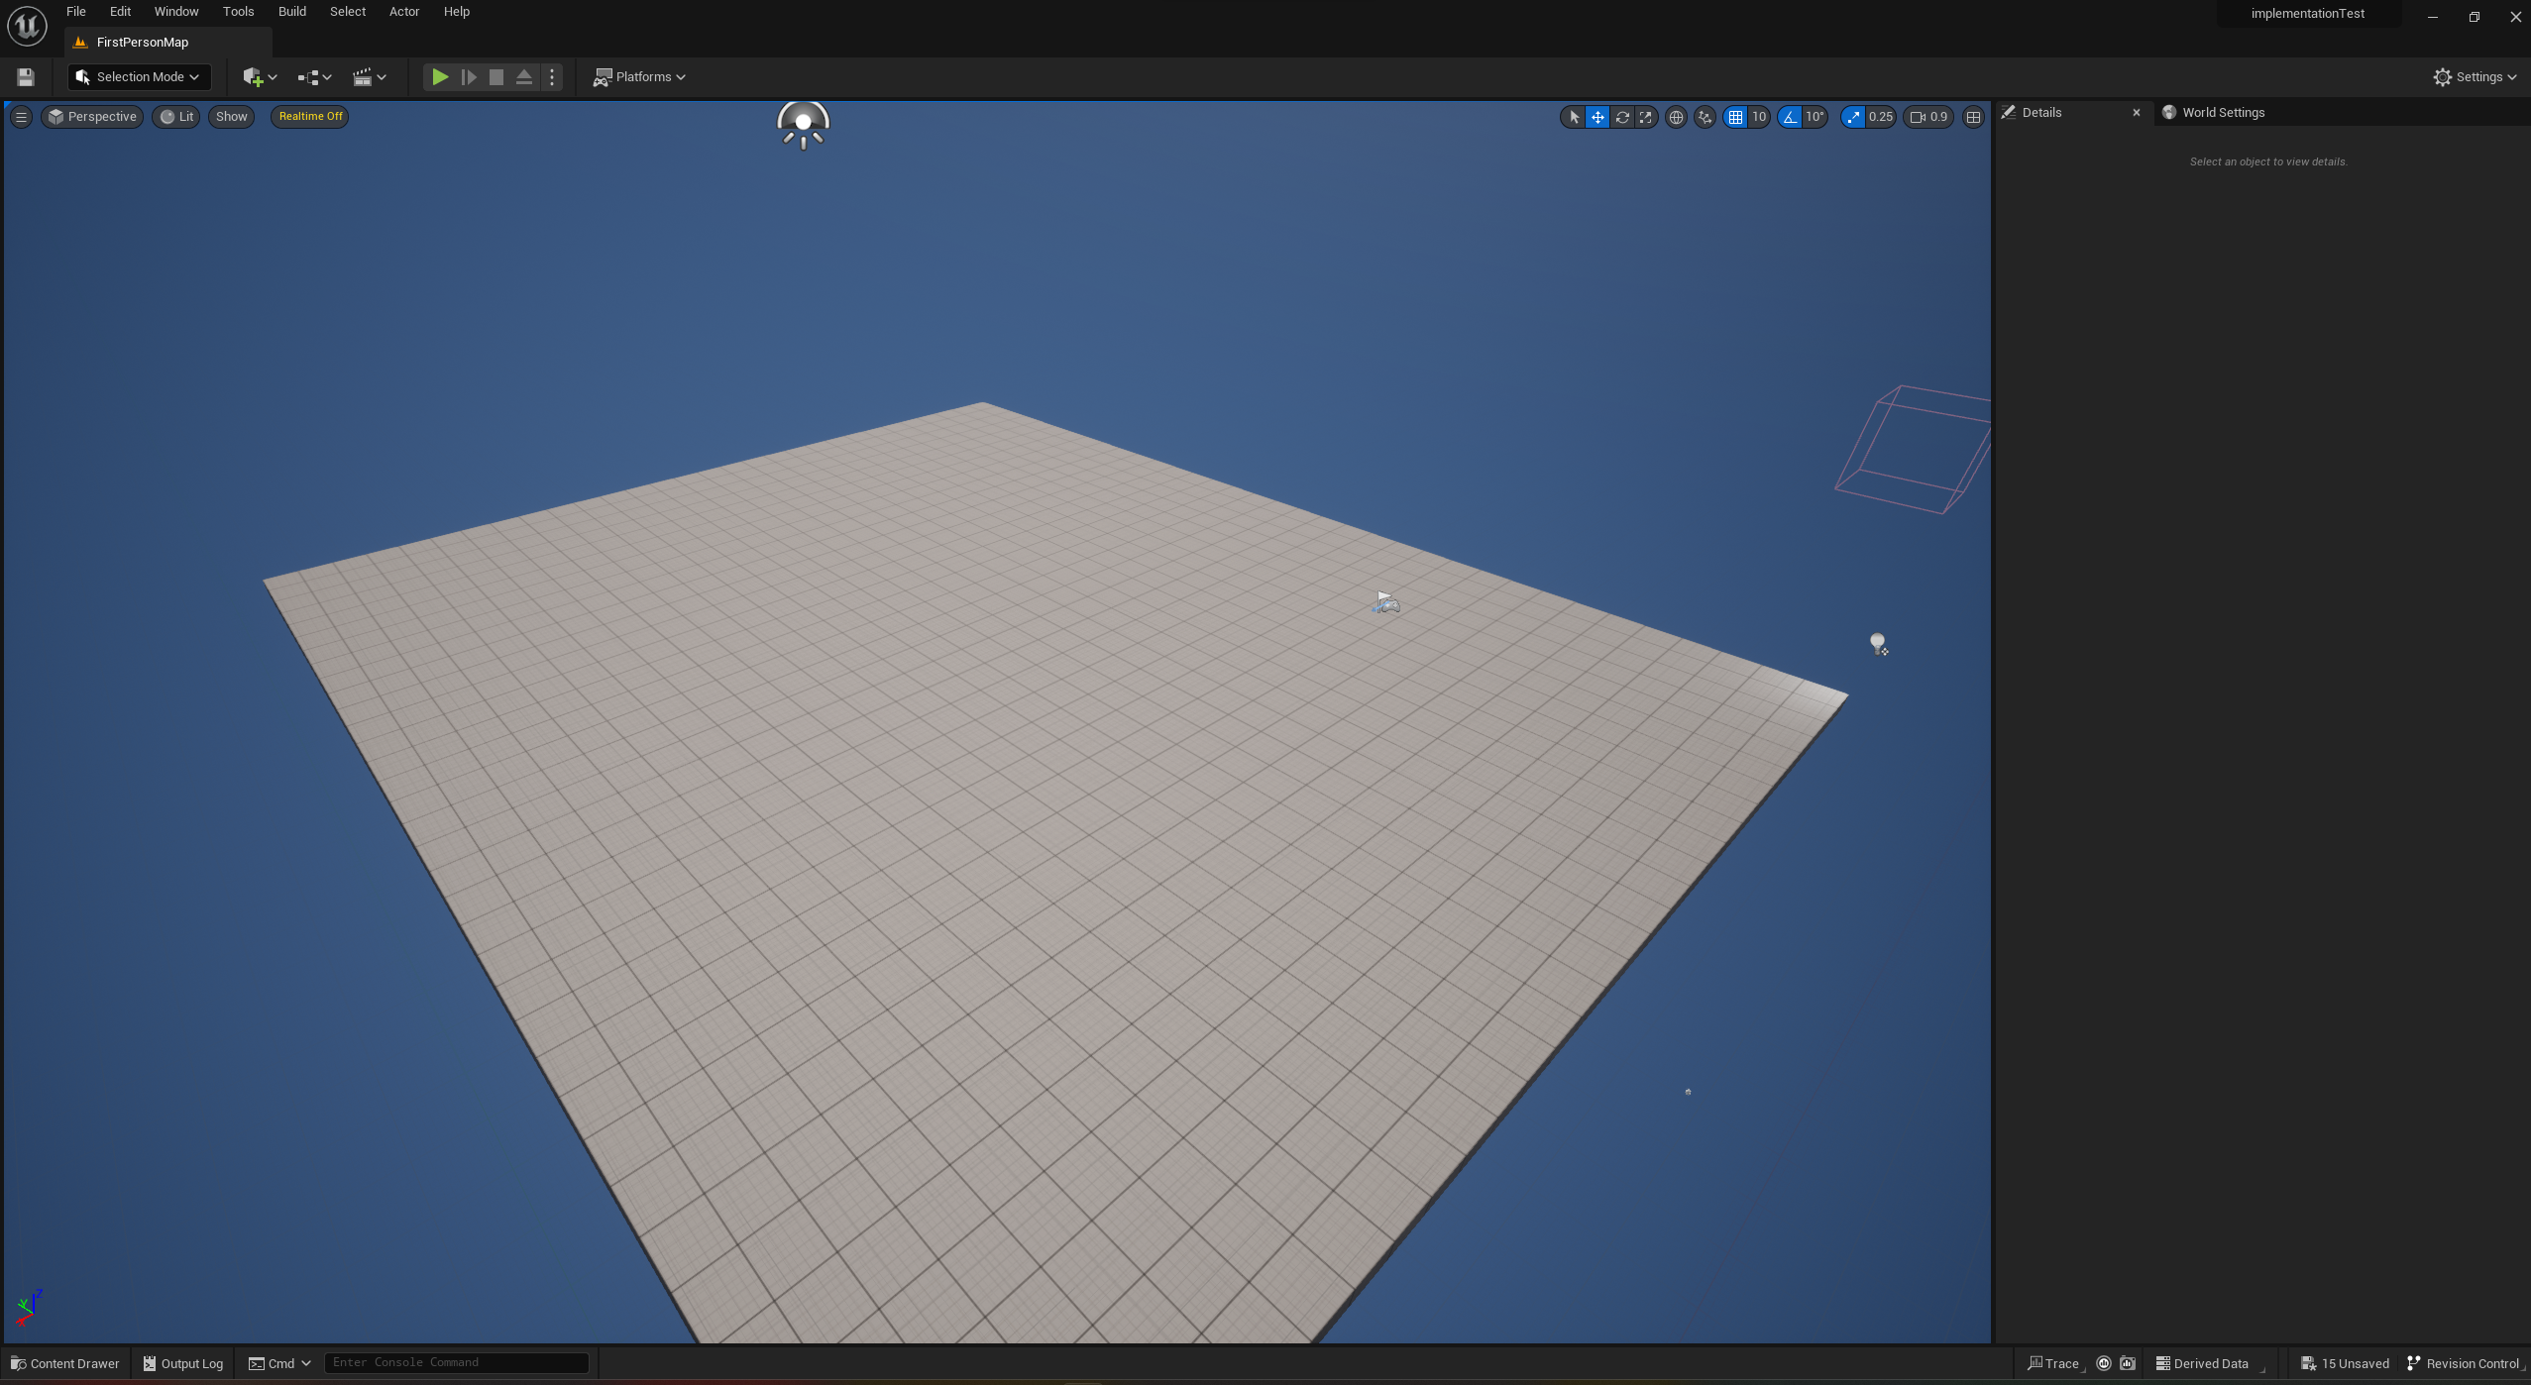
Implementation In Unreal Engine 5 Part 1
The first stage In implementing my game into unreal engine was to export all of my models I had made previously as FBX files to ensure they could all be imported into Unreal Engine without any compatibility issues. After exporting all my files, I went into Unreal Engine and created a first-person project and cleared out all the unnecessary objects and features built into the template.

Slide 17
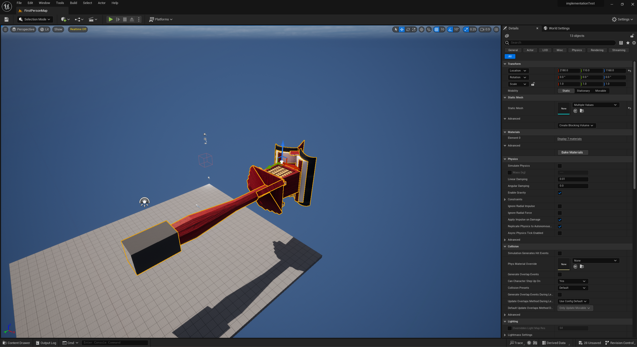
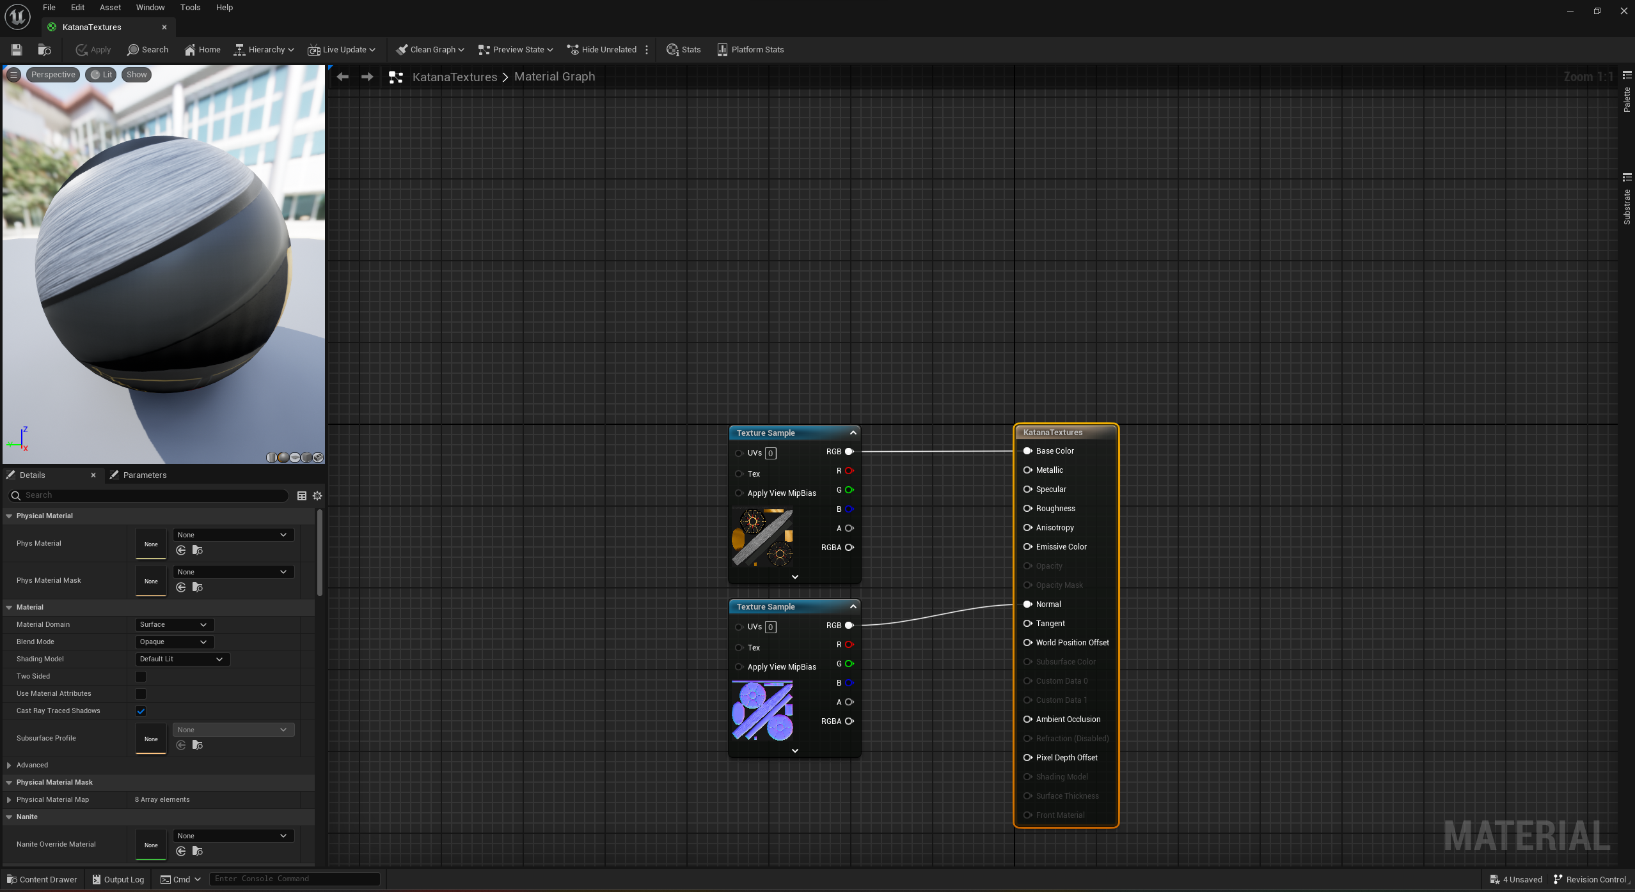
Implementation In Unreal Engine 5 Part 2
The next step that was necessary was to import all my models into their own files. After doing this I could freely place my models into my scene to be freely scaled moved and rotated around. Most of my models were imported with their textures already applied to them but some parts weren’t imported properly so I did need to manually create a material in unreal to add my textures to. This process is essentially the same as applying materials and textures in blender or 3DS max.

Slide 18
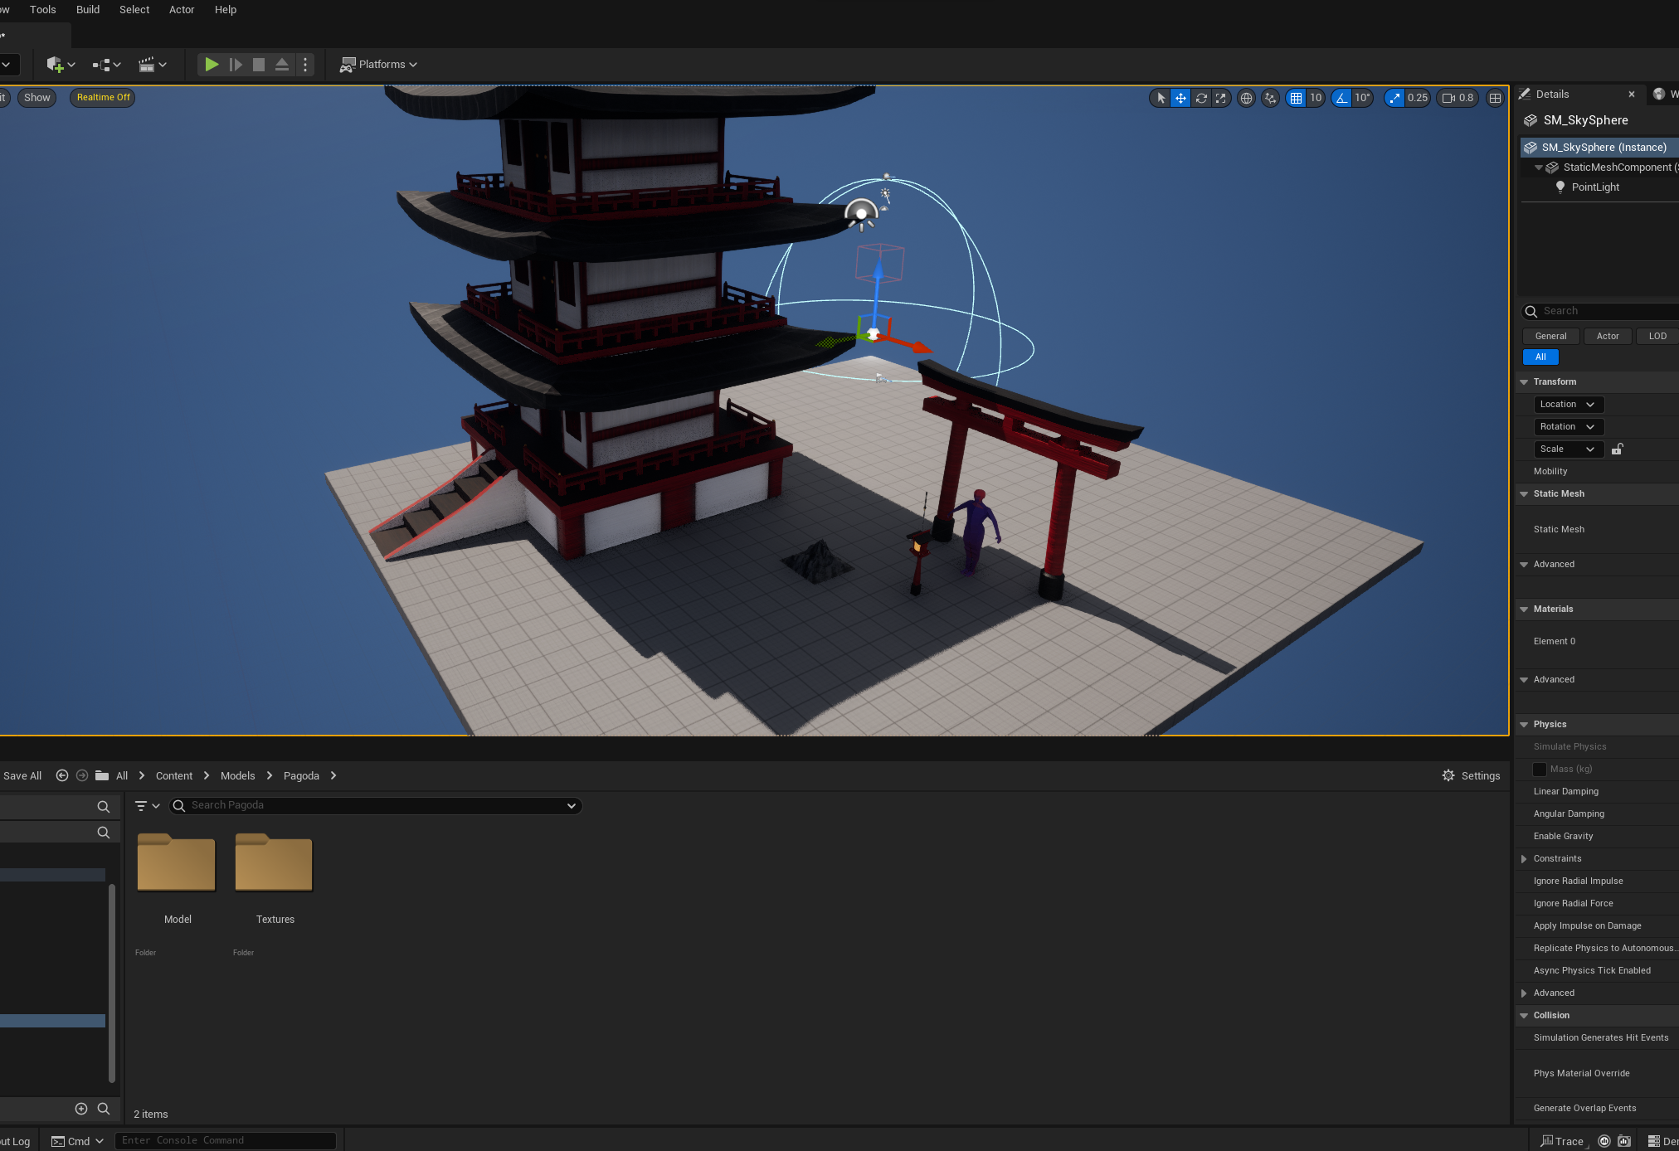
Implementation In Unreal Engine 5 Part 3
In this stage all of my models had been successfully imported into my scene after ensuring all of my models were imported properly and my materials were applied I could begin on setting up my scene.

Slide 19
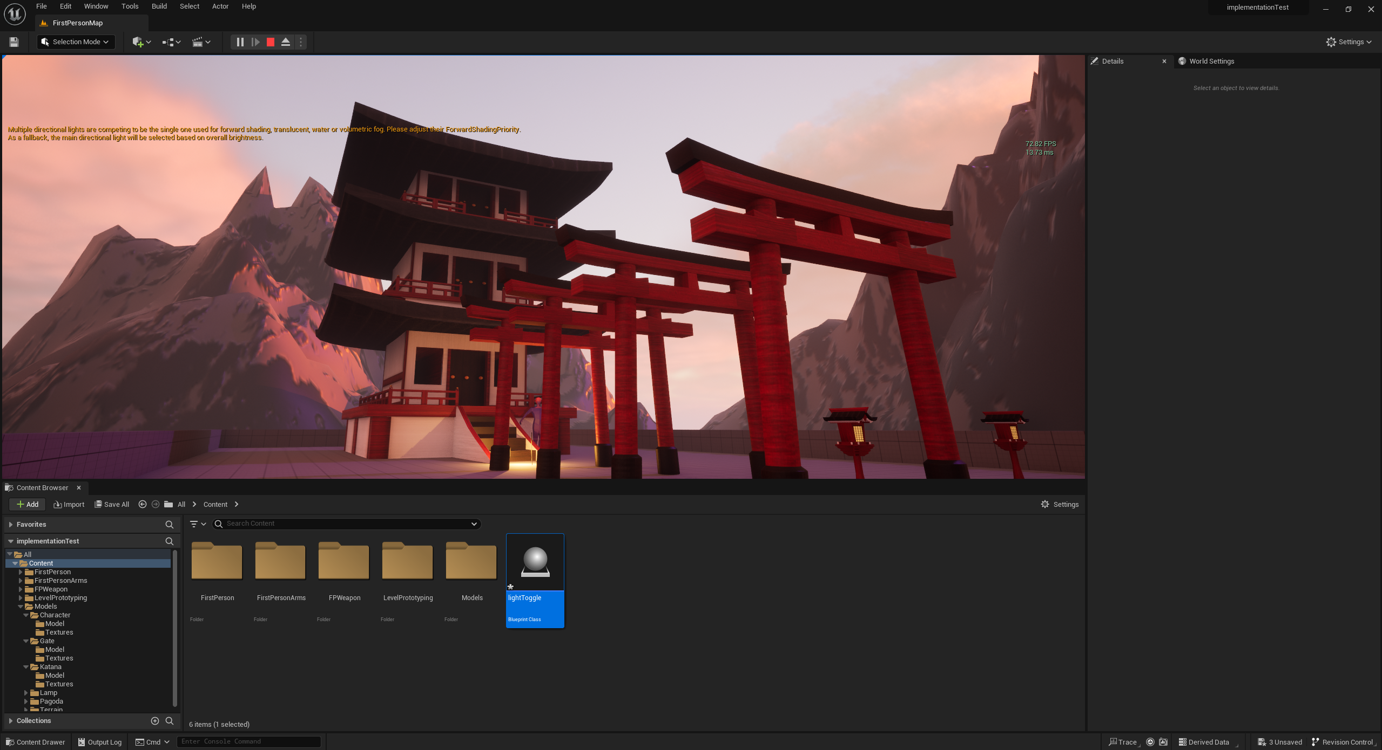
Implementation In Unreal Engine 5 Part 4
Here is a screenshot after setting up my scene. I made a few instances of some models like the mountains in the back and the gates and lamps leading to the pagoda which were all duplicated and scaled to an appropriate size to create the scene. I also added 3 different light sources a purple and a more orange directional light to create the atmospheric lighting effects. I also added one strong point light by the base of the pagoda next to my Katana model to draw the player through gates towards it.

Slide 20
Talk about adding sound and building project when possible

Slide 21
Do sound design part here

